Slide 1
SDLC Recommendations Roadmap
09/06/2022

Slide 2
Agenda
EXECUTIVE SUMMARY | 04 – 12
KEY RECOMMENDATIONS DEEP DIVE | 13 – 25
HOW TO BE AHEAD OF THE MARKET | 26 – 44
1 – Nexus for Insurance 2 – Look at Insurtechs 3 – Test automation 4 – Clarify roles & responsibilities | 27 – 32 33 – 35 36 – 40 41 – 44
ANNEX | 45 – 58

Slide 3
Executive summary

Slide 4
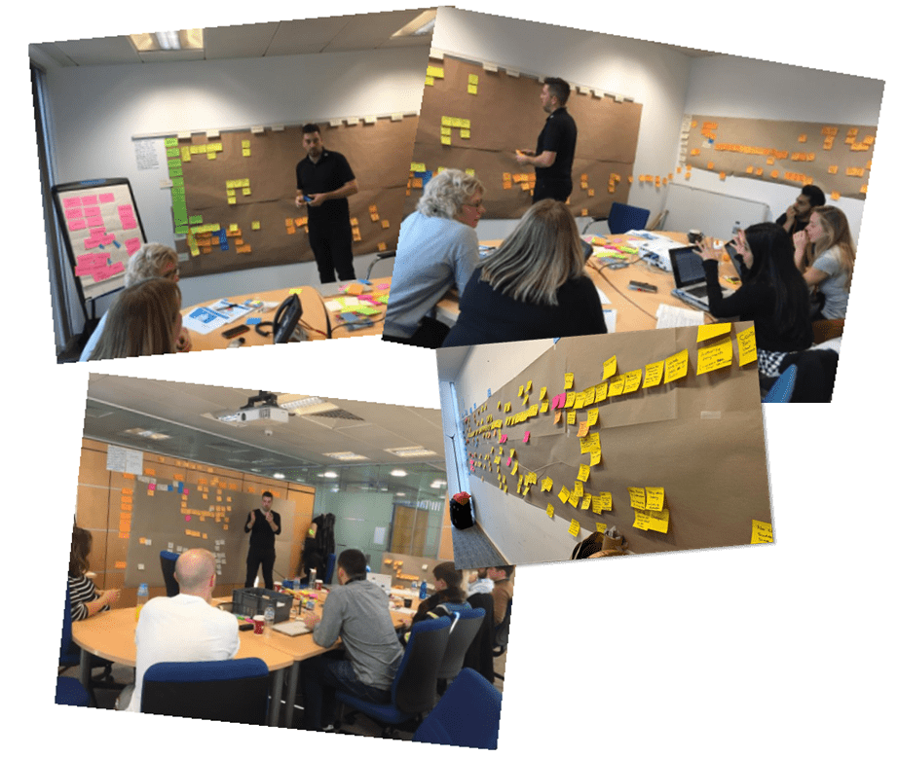
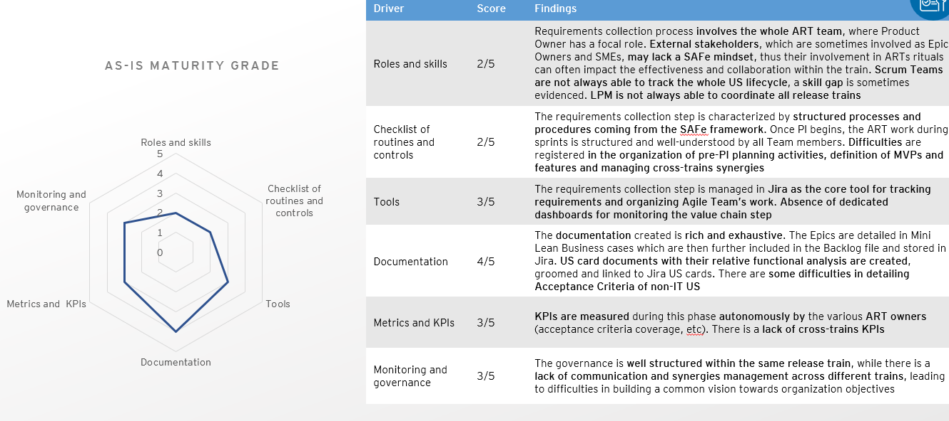
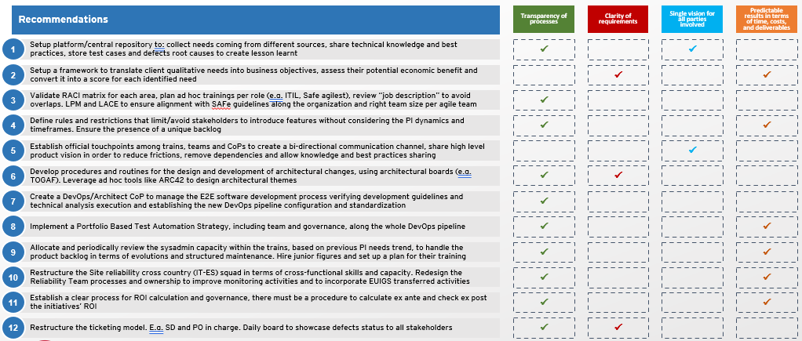
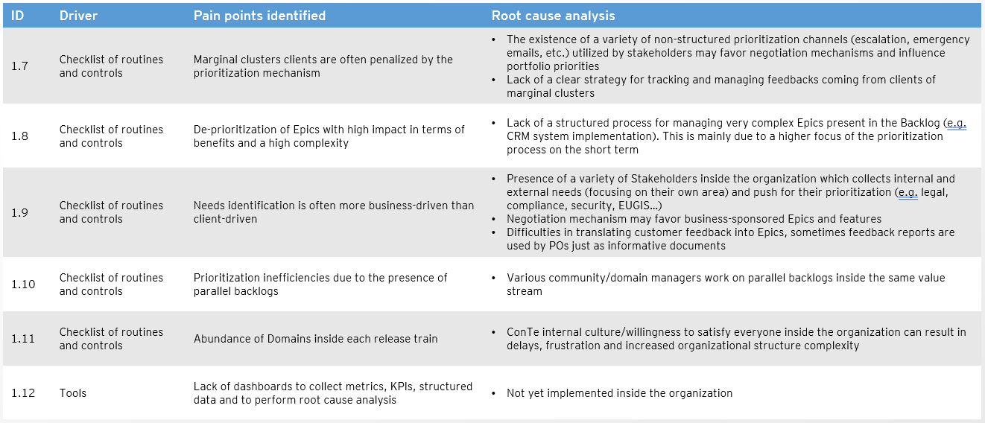
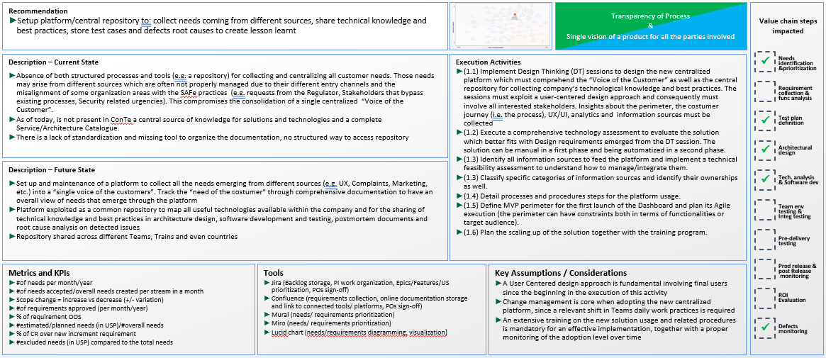
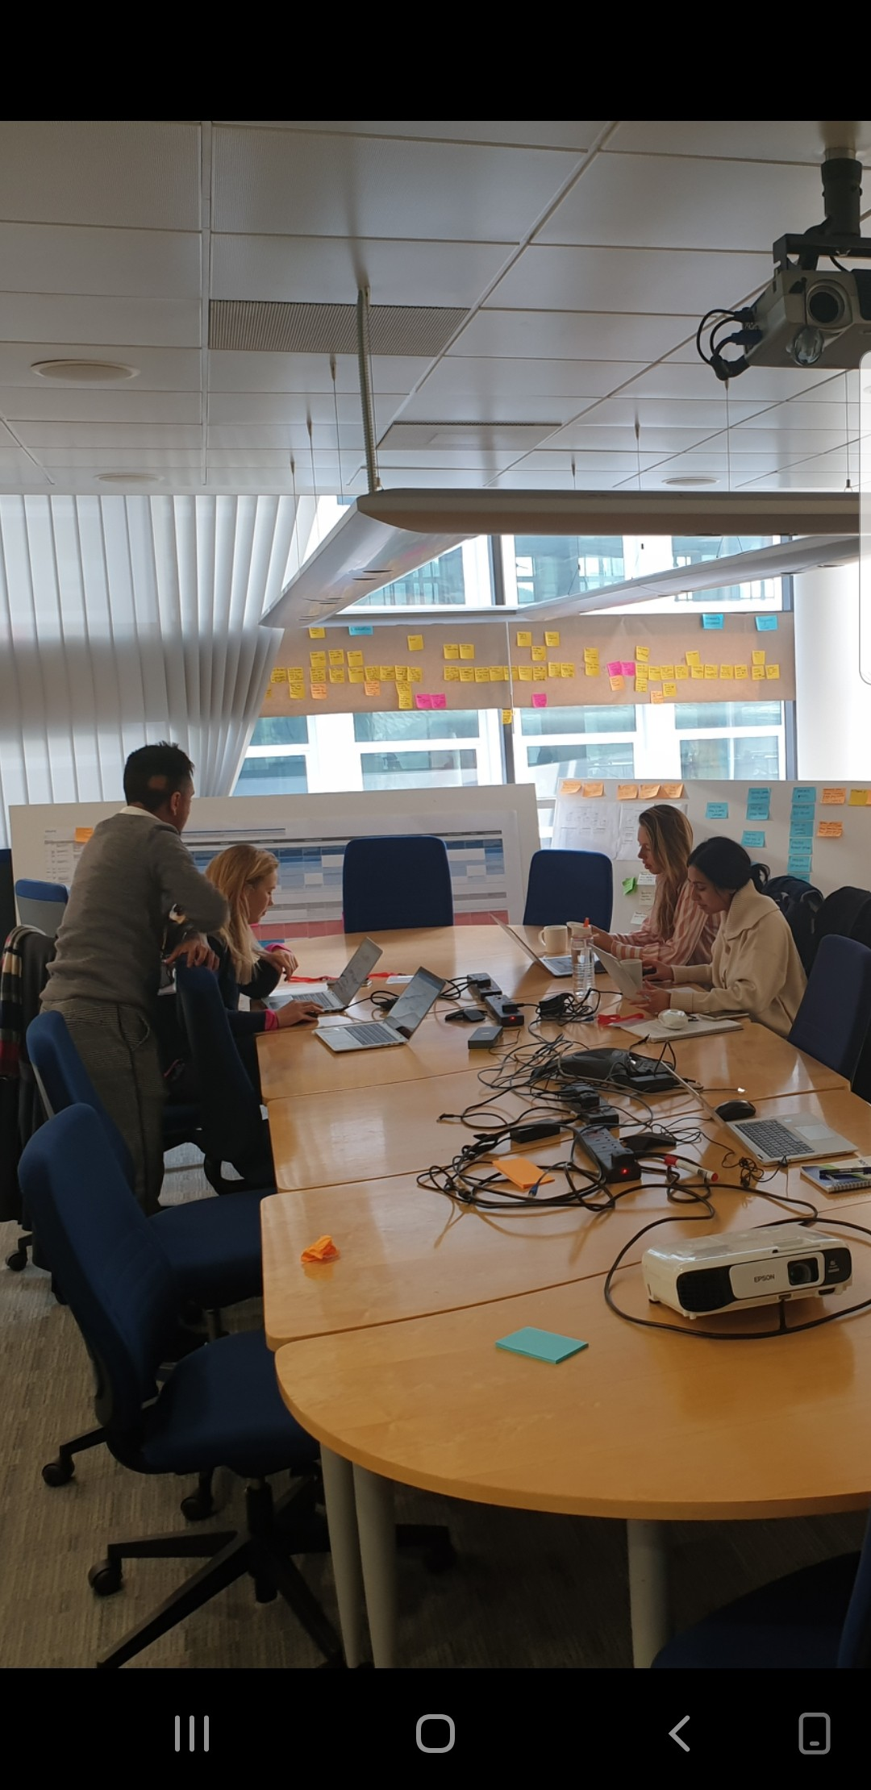
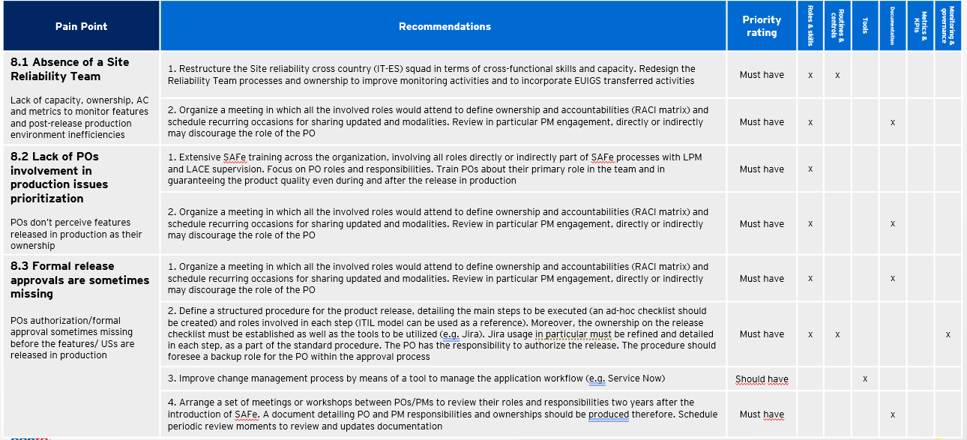
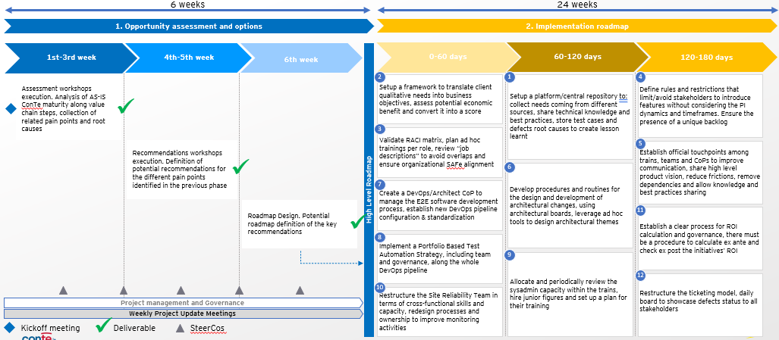
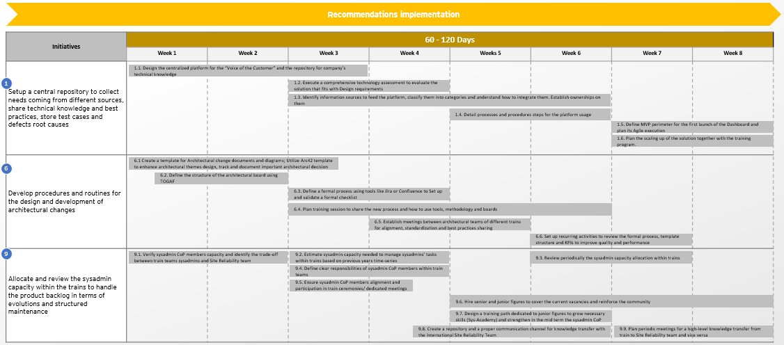
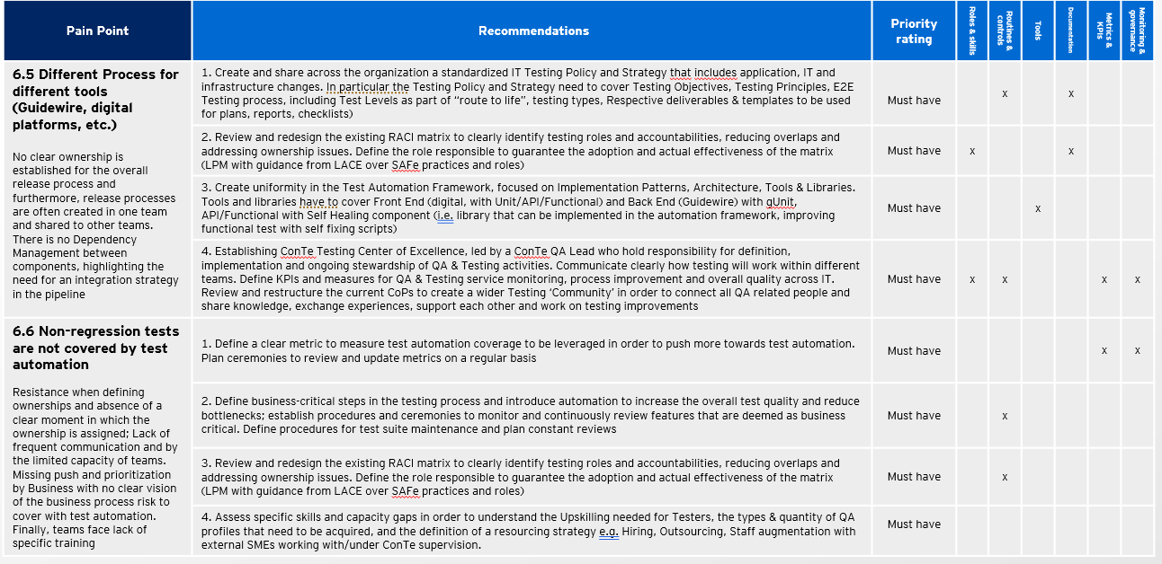
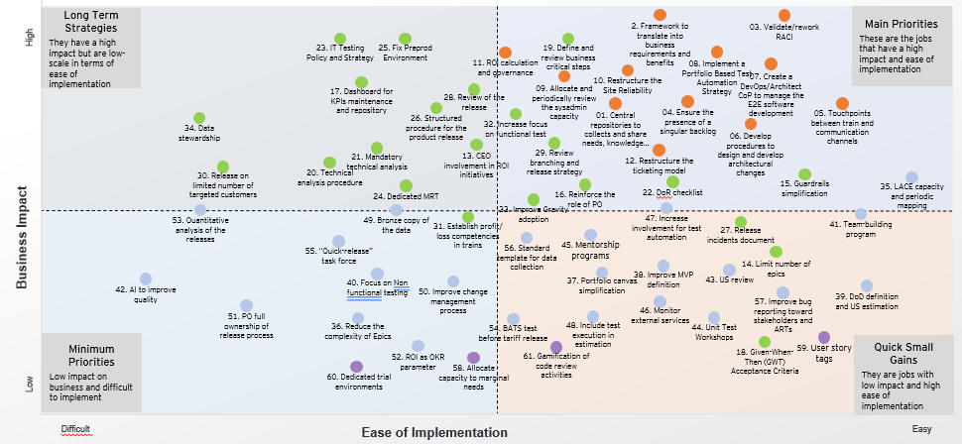
Few numbers
Conducted
Identified
Resulting in
21
96
12
Workshops
to assess AS-IS state of CompanyA SDLC value chain and to brainstorm together around recommendations
Pain points
and related root causes along the the value chain
Key Recommendations and actions to take to make them actionable
Interviewed
Produced
And
18
61
1
Value chain owners and SMEs to collect findings and discuss recommendations
Recommendations with different levels of priority and ease of implementation
Proposed Roadmap focusing on how to bring live the key ones

Slide 5
Priority Map for the recommendations defined along the project...
Long Term Strategies
They have a high impact but are low-scale in terms of ease of implementation
Main Priorities
These are the jobs that have a high impact and ease of implementation
High
03. Validate/review RACI
23. IT Testing Policy and Strategy
25. Fix Preprod Environment
2. Translate qualitative needs into business requirements
11. ROI calculation and governance
19. Define and review business critical steps
10. Restructure the Site Reliability
08. Implement a Portfolio Based Test Automation Strategy
17. Dashboard for KPIs maintenance and repository
28. Review of the release
09. Allocate and periodically review the sysadmin capacity
07. Create a DevOps/Architect CoP to manage the E2E software development
34. Data stewardship
26. Structured procedure for the product release
32. Increase focus on functional test
01. Set up a platform/central repository
04. Ensure the presence of a singular backlog
05. Establish communication channels and Touchpoints between trains
21. Mandatory technical analysis
13. CEO involvement in ROI initiatives
29. Review branching and release strategy
12. Restructure the ticketing model
06. Define procedures to design and develop architectural changes
30. Release on limited number of targeted customers
20. Technical analysis procedure
15. Guardrails simplification
24. Dedicated MRT
16. Reinforce the role of PO
22. DoR checklist
35. LACE capacity and periodic mapping
49. Bronze copy of the data
33. Improve Gravity adoption
Business Impact
53. Quantitative analysis of the releases
31. Establish profit/ loss competencies in trains
47. Increase involvement for test automation
27. Release incidents document
41. Team-building program
55. “Quick-release” task force
56. Standard template for data collection
45. Mentorship programs
38. Improve MVP definition
14. Limit number of epics
40. Focus on Non functional testing
37. Portfolio canvas simplification
43. US review
42. AI to improve quality
50. Improve change management process
39. DoD definition and US estimation
51. PO full ownership of release process
46. Monitor external services
57. Improve bug reporting toward stakeholders and ARTs
Minimum Priorities
Low impact on business and difficult to implement
36. Reduce the complexity of Epics
54. BATS test before tariff release
48. Include test execution in estimation
44. Unit Test Workshops
Quick Small Gains
They are jobs with low impact and high ease of implementation
52. ROI as OKR parameter
18. Given-When-Then (GWT) Acceptance Criteria
59. User story tags
Low
58. Allocate capacity to marginal needs
61. Gamification of code review activities
60. Dedicated trial environments
Difficult
Ease of Implementation
Easy
Key Recommendation
Must have
Should have
Nice to have

Slide 6
Priority Map for the recommendations defined along the project...
Long Term Strategies
They have a high impact but are low-scale in terms of ease of implementation
Main Priorities
These are the jobs that have a high impact and ease of implementation
High
03. Validate/review RACI
23. IT Testing Policy and Strategy
25. Fix Preprod Environment
2. Translate qualitative needs into business requirements
11. ROI calculation and governance
19. Define and review business critical steps
10. Restructure the Site Reliability
08. Implement a Portfolio Based Test Automation Strategy
17. Dashboard for KPIs maintenance and repository
28. Review of the release
09. Allocate and periodically review the sysadmin capacity
07. Create a DevOps/Architect CoP to manage the E2E software development
34. Data stewardship
26. Structured procedure for the product release
32. Increase focus on functional test
01. Set up a platform/central repository
04. Ensure the presence of a singular backlog
05. Establish communication channels and Touchpoints between trains
21. Mandatory technical analysis
13. CEO involvement in ROI initiatives
29. Review branching and release strategy
12. Restructure the ticketing model
06. Define procedures to design and develop architectural changes
30. Release on limited number of targeted customers
20. Technical analysis procedure
15. Guardrails simplification
24. Dedicated MRT
16. Reinforce the role of PO
22. DoR checklist
35. LACE capacity and periodic mapping
49. Bronze copy of the data
33. Improve Gravity adoption
Business Impact
53. Quantitative analysis of the releases
31. Establish profit/ loss competencies in trains
47. Increase involvement for test automation
27. Release incidents document
41. Team-building program
55. “Quick-release” task force
56. Standard template for data collection
45. Mentorship programs
38. Improve MVP definition
14. Limit number of epics
40. Focus on Non functional testing
37. Portfolio canvas simplification
43. US review
42. AI to improve quality
50. Improve change management process
39. DoD definition and US estimation
51. PO full ownership of release process
46. Monitor external services
57. Improve bug reporting toward stakeholders and ARTs
Minimum Priorities
Low impact on business and difficult to implement
36. Reduce the complexity of Epics
54. BATS test before tariff release
48. Include test execution in estimation
44. Unit Test Workshops
Quick Small Gains
They are jobs with low impact and high ease of implementation
52. ROI as OKR parameter
18. Given-When-Then (GWT) Acceptance Criteria
59. User story tags
Low
58. Allocate capacity to marginal needs
61. Gamification of code review activities
60. Dedicated trial environments
Difficult
Ease of Implementation
Easy
Key Recommendation
Must have
Should have
Nice to have

Slide 7
For CompanyA to see benefits in relatively short-term we recommend to put in place key ones in the next 6 months
6 weeks
24 weeks
1. Opportunity assessment and options
2. Implementation roadmap
1st-3rd week
4th-5th week
6th week
High Level Roadmap
0-60 days
60-120 days
120-180 days
2
1
4
Assessment workshops execution. Analysis of AS-IS CompanyA maturity along value chain steps, collection of related pain points and root causes
Setup a framework to translate client qualitative needs into business objectives, assess potential economic benefit and convert it into a score
Setup a platform/central repository to: collect needs coming from different sources, share technical knowledge and best practices, store test cases and defects root causes to create lesson learnt
Define rules and restrictions that limit/avoid stakeholders to introduce features without considering the PI dynamics and timeframes. Ensure the presence of a unique backlog
✓
3
Validate RACI matrix, plan ad hoc trainings per role, review “job descriptions” to avoid overlaps and ensure organizational SAFe alignment
5
Recommendations workshops execution. Definition of potential recommendations for the different pain points identified in the previous phase
Establish official touchpoints among trains, teams and CoPs to improve communication, share high level product vision, reduce frictions, remove dependencies and allow knowledge and best practices sharing
✓
6
Develop procedures and routines for the design and development of architectural changes, using architectural boards, leverage ad hoc tools to design architectural themes
7
Create a DevOps/Architect CoP to manage the E2E software development process, establish new DevOps pipeline configuration & standardization
Roadmap Design. Potential roadmap definition of the key recommendations
✓
11
Establish a clear process for ROI calculation and governance, there must be a procedure to calculate ex ante and check ex post the initiatives’ ROI
8
Implement a Portfolio Based Test Automation Strategy, including team and governance, along the whole DevOps pipeline
9
Allocate and periodically review the sysadmin capacity within the trains, onboard junior figures and set up a plan for their training
12
10
Restructure the ticketing model, daily board to showcase defects status to all stakeholders
Restructure the Site Reliability Team in terms of cross-functional skills and capacity, redesign processes and ownership to improve monitoring activities
Project management and Governance
Weekly Project Update Meetings
✓
Kickoff meeting
Deliverable
SteerCos

Slide 8
Roadmap (1/3)
Recommendations implementation
Recommendation | 0-60 Days |  |  |  | ~August 11th – September 26th
 | Week 1 | Week 2 | Week 3 | Week 4 | Weeks 5 | Week 6 | Week 7 | Week 8
Setup a framework to translate client qualitative needs into business objectives, assess potential economic benefit and convert it into a score
Validate RACI matrix, plan ad hoc training per role, review “job descriptions” to avoid overlaps and ensure organizational SAFe alignment
Create a DevOps/Architect CoP to manage the E2E software development process, establish new DevOps pipeline configuration & standardization
Implement a Portfolio Based Test Automation Strategy, including team and governance, along the whole DevOps pipeline
Restructure the Site Reliability Team in terms of cross-functional skills and capacity, redesign processes and ownership to improve monitoring activities
2
2.1 Map the list of qualitative feedbacks and their entry channels to have a comprehensive view on them
2.2 Cluster feedbacks into specific categories and define attributes that characterize each category
2.3 Execute workshops to define the set of fields required and their template to create the scoring and to weight needs economic benefits
2.4 Define a procedure to manage feedbacks that do not fit with the existing categories
2.6 Update the scoring model according to new categories
2.5 Define ownership on the procedure and share the template with the organization
2.7 Provide training if needed
3
3.1 Review job description
3.2 Identify and add new roles in the organization if required
3.3 Execute workshops to review/ validate existing/design new RACI matrix
3.4 Carry out skill coverage assessments on key roles. Plan ad hoc training on key roles if needed
3.5 Execute extensive trainings to align people competencies with jobs descriptions. Define a plan for continuous learning
3.6 Define governance framework to guarantee the effective adoption and update the matrix
7
7.1 Identify the set of resources to create the DevOps/Architect CoP
7.2 integrate into the RACI model the new CoP
7.3 Implement dedicated training
7.4 Review the SDLC in the technical analysis, testing, release in production, decision making and approval tasks activities
7.5 Review pipeline configuration
7.6 Provide extensive training on the new pipeline configuration
8
8.1 Define a Portfolio Based Test Automation Strategy outlining Test Automation objectives
8.2 Define test automation process
8.3 Review Teams and Governance
8.6 Review and restructure the current CoPs and create a CompanyA “Testing Center of Excellence”
8.4 Plan a continuous review and maintenance of test environments and data
8.5 Improve and constantly review test metrics used to monitor test
8.7 Develop automation specific ROI calculation
10
8.8 Share test-vision with all team members
10.1 Split Sysadmin CoP members between trains and Site Reliability Team
10.2 Review and reconstruct Site Reliability cross country team
10.3 Onboard ad hoc figures to cover current vacancies and reinforce the community
10.4 Design a training path dedicated to junior figures to grow necessary skills
10.6 Establish clear metrics and processes; formalize reporting procedures
10.5 Formalize the list of activities to be carried out by the Site Reliability team and integrate into the RACI model the new team
10.7 Plan periodic meetings for a high-level knowledge transfer from train to Site Reliability team

Slide 9
Roadmap (2/3)
Recommendations implementation
Recommendation | 60 - 120 Days |  |  |  | ~August 11th – September 26th
 | Week 1 | Week 2 | Week 3 | Week 4 | Weeks 5 | Week 6 | Week 7 | Week 8
Setup a platform/central repository to: collect needs coming from different sources, share technical knowledge and best practices, store test cases and defects root causes to create lesson learnt
Develop procedures and routines for the design and development of architectural changes, using architectural boards, leverage ad hoc tools to design architectural themes
Allocate and periodically review the sysadmin capacity within the trains, onboard junior figures and set up a plan for their training
1
1.1. Design the centralized platform/repository for “Voice of the Customer”/company’s tech. knowledge, etc. involving all stakeholders
1.2. Execute a comprehensive technology assessment to evaluate the solution that fits with Design requirements
1.3. Identify information sources to feed the platform/ repository, classify them into categories and understand how to integrate them
1.4. Detail processes and procedures steps for the platform usage
1.5. Define MVP perimeter for the first launch of the Dashboard and plan its Agile execution
1.6. Plan scaling up of the solution and training program
6
6.1 Define a standard template for Architectural change documents and diagrams
6.2. Define the architectural board using TOGAF
6.3. Define a process for the design and development of architectural changes and validate a formal checklist follow
6.4. Plan training session to share new process, tools, methodology and boards
6.5. Establish periodic meetings between architectural teams of different trains for alignment, standardization and best practices sharing
6.6. Set up recurring activities to review the formal process, template structure and KPIs to improve quality and performance
9
9.1. Verify sysadmin CoP members capacity and identify trade-offs between train teams sysadmins and Site Reliability team
9.2. Estimate and allocate sysadmin capacity needed to manage sysadmins’ tasks within trains based on previous years time-series
9.3. Define responsibilities of sysadmin CoP members within train teams and integrate them into the RACI model
9.4. Ensure sysadmin CoP members alignment and participation in train ceremonies
9.5. Onboard senior and junior figures to cover the current vacancies and reinforce the community
9.6. Design a training path dedicated to junior figures to grow necessary skills (Sys-Academy) and strengthen in the mid term the sysadmin CoP
9.8. Plan periodic meetings for KT with Site Reliability team
9.7. Create a repository and a proper communication channel for knowledge transfer with the international Site Reliability Team
9.9. Review the sysadmin capacity allocation within trains

Slide 10
Roadmap (3/3)
Recommendations implementation
Recommendation | 120 - 180 Days |  |  |  | ~August 11th – September 26th
 | Week 1 | Week 2 | Week 3 | Week 4 | Weeks 5 | Week 6 | Week 7 | Week 8
Define rules and restrictions that limit/avoid stakeholders to introduce features without considering the PI dynamics and timeframes. Ensure the presence of a unique backlog
Establish official touchpoints among trains, teams and CoPs to improve communication, share high level product vision, reduce frictions, remove dependencies and allow knowledge and best practices sharing
Establish a clear process for ROI calculation and governance, there must be a procedure to calculate ex ante and check ex post the initiatives’ ROI
Restructure the ticketing model, daily board to showcase defects status to all stakeholders
4
4.1. Identify stakeholders introducing new features to Trains backlog during PI, track entry channels, frequency and impact
4.2. Define a strict set of rules for backlog management, limit the set of channels as source of new requirements
4.3. Define periodic Portfolio management activities for the long-term backlog planning
4.4. Implement an internal “audit” process to identify the presence of multiple backlogs. Carry out root cause analysis to document the issue and plan remediation actions
4.5. Setup periodic LPM governance meeting to monitor KPIs for PI scope changes, detecting and mapping alternative needs entry channels
5
5.1. Enhance structured Agile ceremonies (scope, attendee, and timebox) by including all people/roles interested, requiring participation and commitment
5.2. Define and share ceremonies plan defining participants, meeting goals and outputs
5.3. Define ad hoc communication channels and link to shared repository to store ceremonies outputs
5.4. Create a newsletter to inform the organization about Change Management and best practices
5.5. Set up a quarterly meeting for each train to share objectives and results, discuss new opportunities, organize workshops
11
11.1. Setup a series of meetings to identify the type of initiatives to be addressed for ROI calculation, defining the desired level of granularity
11.2. Create a cross-Train ROI Competence Team
11.3. Establish rules for estimating Story Points
11.4. Exploit quantitative scoring to estimate initiative’s benefits for ROI calculation
11.5. Define a process for information tracking and ROI calculation
11.6. Setup a governance plan and periodically monitor ROI (LPM and LACE)
12
12.1. Setup a process to manage tickets in production, define a defects monitoring procedure, the set of information and a standard template that both SD and POs need to provide and receive
12.2. Define with stakeholders the information that need to be shared in the bugs monitoring report
12.3. Carry out monthly bug reporting and share it with the list of stakeholders
12.4. boost monitoring tool utilization to improve monitoring and incident management process
12.5 Use shared repository to track documents for post-mortem and root-causes analysis regarding production disruption

Slide 11

How we can Help You during this 6 months phase
Option 1:
EY leading Initiatives implementation with ad hoc team in place
Option 2:
EY providing ad hoc SMEs as per CompanyA needs
Project Team
Key activities
Support CompanyA in the detailed plan execution, ensuring timeline is respected and activities carrying on timely
1
2
3
4
PM
5
6
7
8
9
10
11
12
PM
Follow activities execution, support CompanyA and PM in daily activities and meetings organization and governance
1
2
3
4
Consultant
5
6
7
8
9
10
11
12
Consultant
Consultant
Consultant
Consultant
Identify best platforms/ repositories/ tools utilized/designed in the market; review/design RACI matrix with necessary roles for each organization area
1
2
3
4
Safe Agilist
5
6
7
8
9
10
11
12
Assess and define skills/knowledge gaps, and setup ad hoc training plans throughout the organization
1
2
3
4
Quality Assurance
Agile Coach
5
6
7
8
9
10
11
12
Design and implement CompanyA DevOps pipeline configuration including automation and E2E software development process management
1
2
3
4
SME
DevOps SME
5
6
7
8
9
10
11
12
Support CompanyA to set up a portfolio-based test automation strategy adopting a risk-based test approach tailored on CompanyA specific needs
1
2
3
4
Test Expert
5
6
7
8
Agile Coach
Senior Architect
DevOps SME
Test Expert
9
10
11
12
Safe Agilist
Define standard process, templates and formal checklist to be adopted for the design and development of the architectural changes
1
2
3
4
Senior Architect
5
6
7
8
9
10
11
12

Slide 12
Key recommendations deep dive

Slide 13
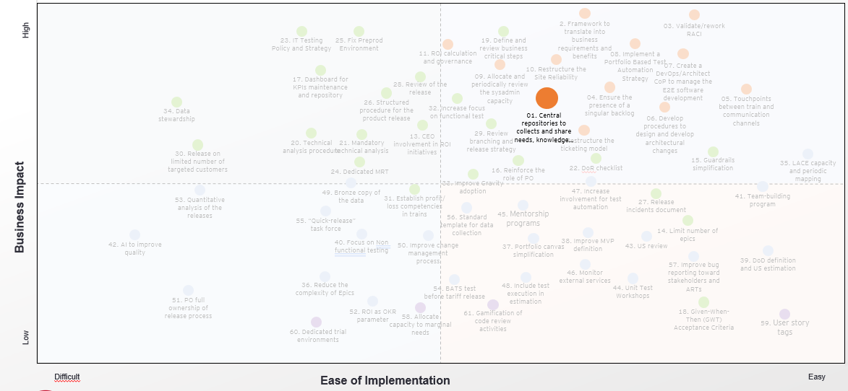
Benefit
Transparency of processes
Clarity of requirements
Single vision of a product for all the parties involved
Predictable results in terms of time, costs, and deliverables
Recommendation (1/12)
Recommendation
Setup platform/central repository to: collect needs coming from different sources, share technical knowledge and best practices, store test cases and defects root causes to create lesson learnt
Transparency of Process
&
Single vision of a product for all the parties involved
Value chain steps
impacted
Description – Current State
Absence of both structured processes and tools (e.g. a repository) for collecting and centralizing all customer needs. Those needs may arise from different sources which are often not properly managed due to their different entry channels and the misalignment of some organization areas with the SAFe practices (e.g. requests from the Regulator, Stakeholders that bypass existing processes, Security related urgencies). This compromises the consolidation of a single centralized “Voice of the Customer”
As of today, is not present in CompanyA a central source of knowledge for solutions and technologies and a complete Service/Architecture Catalogue
There is a lack of standardization and missing tool to organize the documentation, no structured way to access repository
Execution Activities
(1.1) Implement Design Thinking (DT) sessions to design the new centralized platform which must comprehend the “Voice of the Customer” as well as the central repository for collecting company’s technological knowledge and best practices. The sessions must exploit a user-centered design approach and consequently must involve all interested stakeholders. Insights about the perimeter, costumer journey (i.e. the process), UX/UI, analytics and information sources must be collected
(1.2) Execute a comprehensive technology assessment to evaluate the solution which better fits with Design requirements emerged from the DT session. The solution can be manual in a first phase and being automatized in a second phase
(1.3) Identify all information sources to feed the platform/repository and implement a technical feasibility assessment to understand how to manage/integrate them
(1.4) Detail processes and procedures steps for the platform usage
(1.5) Define MVP perimeter for the first launch of the Dashboard and plan its Agile execution (the perimeter can have constraints both in terms of functionalities or target audience)
(1.6) Plan the scaling up of the solution together with the training program
✓
Needs
identification &prioritization
Requirement collection &
func analysis
✓
Test plan
definition
✓
Architectural
design
Description – Future State
Set up and maintenance of a platform to collect all the needs emerging from different sources (e.g. UX, Complaints, Marketing, etc.) into a “single voice of the customers”. Track the “need of the costumer” through comprehensive documentation to have an overall view of needs that emerge through the platform
Platform exploited as a common repository to map all useful technologies available within the company and for the sharing of technical knowledge and best practices in architecture design, software development and testing, postmortem documents and root cause analysis on detected issues
Repository shared across different Teams, Trains and even countries
✓
Tech. analysis
& Software dev
Team env
testing &
Integ testing
Pre-delivery
testing
Metrics and KPIs
#of needs per month/year
#of needs accepted/overall needs created per stream in a month
Scope change = increase vs decrease (+/- variation)
#of requirements approved (per month/year)
% of requirement OOS
#estimated/planned needs (in USP)/#overall needs
% of CR over new increment requirement
#excluded needs (in USP) compared to the total needs
Tools
Jira (Backlog storage, PI work organization, Epics/Features/US prioritization, POs sign-off)
Confluence (requirements collection, online documentation storage and link to connected tools/ platforms, POs sign-off)
Mural (needs/ requirements prioritization)
Miro (needs/ requirements prioritization)
Lucid chart (needs/requirements diagramming, visualization)
Key Assumptions / Considerations
A User Centered design approach is fundamental involving final users since the beginning in the execution of this activity
Change management is core when adopting the new centralized platform, since a relevant shift in Teams daily work practices is required
An extensive training on the new solution usage and related procedures is mandatory for an effective implementation, together with a proper monitoring of the adoption level over time
Prod release & post Release
monitoring
ROI
Evaluation
✓
Defects
monitoring

Slide 14
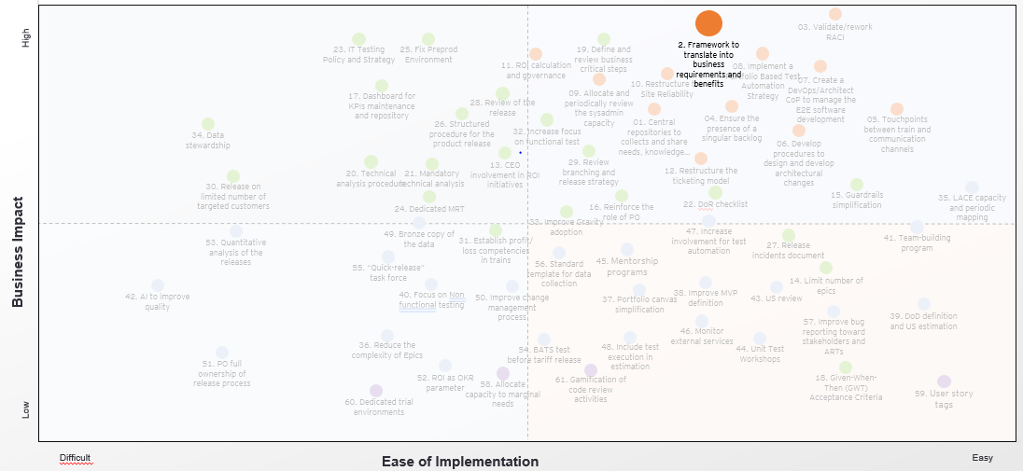
Benefit
Transparency of processes
Clarity of requirements
Single vision of a product for all the parties involved
Predictable results in terms of time, costs, and deliverables
Recommendation (2/12)
Recommendation
Setup a framework to translate client qualitative needs into business requirements, assess their potential economic benefit and convert it into a score for each identified need
Clarity of requirements
&
Predictable results in terms of time, costs, and deliverables
Value chain steps
impacted
Description – Current State
Lack of a shared template that would enable the comparison and evaluation of client needs coming from different sources
Hard to elaborate and translate qualitative feedback into features to be implemented
Needs prioritization and their potential benefits definition is executed by managers, that are not always experts on the specific subject
Execution Activities
(2.1) Map the list of qualitative feedbacks and their entering channels to have a comprehensive view on them
(2.2) Cluster the feedbacks into specific categories and detail the set of attributes which characterize the various categories
(2.3) Execute workshops involving all specific domain experts to discuss a process to convert qualitative customer feedbacks into a quantitative score, in order to weight their potential economic benefits. Define the set of fields required to create the scoring as well as their template, considering peculiarities of previously identified feedback categories and guaranteeing coherence in the translation. This solution can be manual in a first phase and being automatized in a second phase
(2.4) Define a procedure to manage feedbacks that do not fit with the existing categories, i.e. a procedure to review and update the feedbacks mapping
(2.5) Define the ownership on this procedure and share the template across the organization with interested stakeholders, potential Epics Owners as well as with domain owners
(2.6) Update the scoring model to include new possible categories
(2.7) Provide specific training on the template usage where needed
✓
Description – Future State
A method is set up to evaluate potential economic benefits of qualitative needs and to convert it into a defined score
Specific domain experts are involved in the evaluation of the need’s economic benefit and on the definition of the score
The score is standardizable and applicable to needs coming from different sources (e.g. UX, Complaints, Marketing, etc.). A software is adopted to support this process, exploiting AI and ML
Tech. analysis
& Software dev
Prod release & post Release
monitoring
Requirement collection &
func analysis
Architectural
design
Team env
testing &
Integ testing
Needs
identification &prioritization
Test plan
definition
Pre-delivery
testing
ROI
Evaluation
Defects
monitoring
Metrics and KPIs
#of qualitative needs per month/year
#of needs accepted / overall needs created per stream in a month
#of requirements approved (per month/year)
#estimated/planned needs (in USP)/#overall needs
#excluded needs (in USP) compared to the total needs
Tools
Jira (needs/ requirements collection and prioritization)
MS Office
Octane (Backlog storage, PI work organization,POs sign-off)
CloudRepo (Artifact repositories)
Key Assumptions / Considerations
A User Centered design approach is fundamental, involving final users since the beginning in the execution of this activity
An extensive training on the new solution usage and related procedures is mandatory for an effective implementation, together with a proper monitoring of the adoption level over time

Slide 15
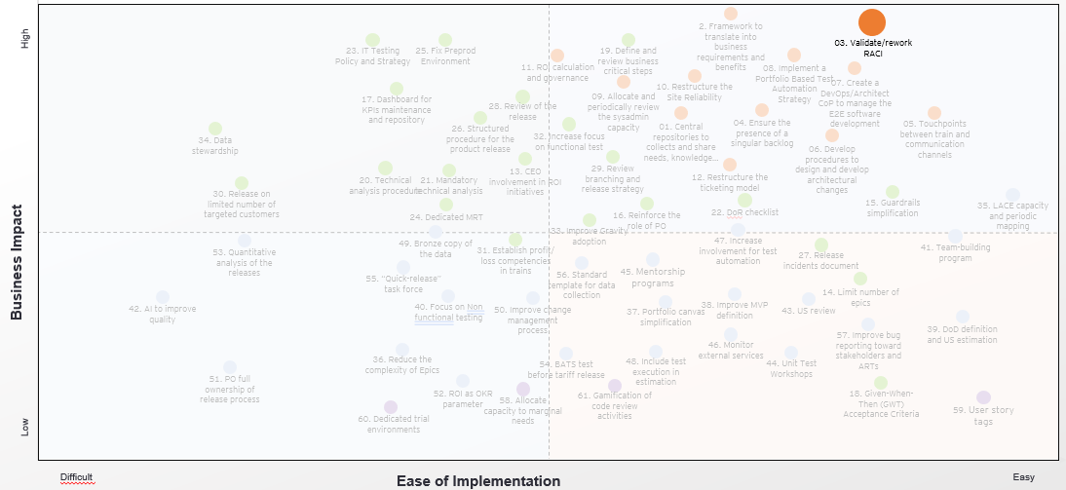
Benefit
Transparency of processes
Clarity of requirements
Single vision of a product for all the parties involved
Predictable results in terms of time, costs, and deliverables
Recommendation (3/12)
Recommendation
Validate/rework RACI matrix for each area, and plan ad hoc training for specific roles (e.g. ITIL, Safe agilest, SM, PMP). Review the “jobs description” to avoid overlaps
Transparency of processes
Value chain steps
impacted
Description – Current State
Job descriptions are sometimes not well-defined and some people have to cover more than one critical organization’s role (e.g. Triads members sometimes cover multiple organizational roles causing a weak role coverage, PMs and POs job description and responsibilities must be reviewed since overlapping with other roles emerged, the role of the Architect is sometimes weak or missing and must be reinforced to guarantee the required capacity)
Lack of a standardized RACI matrix, even when present they have not been adopted properly
Roles involved in the process do not always possess a technical background
Missing standardization of roles and responsibilities, each team may have a different approach/view of the roles
Execution Activities
(3.1) Review job descriptions for existing roles, underlining current state pain points (e.g. overlapping issues), executing RCA to identify root causes and related improvements
(3.2) Identify and add new roles in the organization if required
(3.3) Execute a workshop for RACI matrix review involving all interested people (e.g. C-level company roles, LPM and Triads members , supply chain steps owners, delivery team representatives). For each role previously reviewed, adjust or confirm the existing RACI matrix according to job descriptions. For new roles a brand-new RACI analysis is needed
(3.4) Carry out a skills coverage assessment on organizations’ roles and plan ad hoc training on the ones where a skills gap is detected
(3.5) Execute extensive trainings to align people competencies with jobs descriptions. Define a plan for continues learning and training of resources over time
(3.6) Define a governance framework to guarantee the effective adoption and updating of the matrix. Job descriptions and the RACI matrix must be regularly reviewed over time, in order to always find the configuration best fitting with the organization CompanyAxt. The governance implies clear ceremonies and ownerships
✓
Needs
identification &prioritization
✓
Requirement collection &
func analysis
✓
Test plan
definition
✓
Architectural
design
Description – Future State
The existing RACI matrix is reviewed and redesigned to clearly identify roles and accountabilities, resulting in reduced overlaps and ownership issues addressed
A role responsible to guarantee the adoption and actual effectiveness of the matrix is defined (LPM with guidance from LACE over SAFe practices and roles)
Recurrent meetings are held to review and update the matrix
✓
Tech. analysis
& Software dev
✓
Team env
testing &
Integ testing
✓
Pre-delivery
testing
Metrics and KPIs
Number of job description reviewed/quarter
Number of time the RACI is reviewed/quarter
Number of job description adjustments/quarter
Number of RACI matrix adjustments/quarter
Tools
Lucid chart
MS Office
Key Assumptions / Considerations
Change management is core when adopting the new centralized platform, since a relevant shift in Teams daily work practices is required
Training and upskilling of organization’s resources to fit with roles description is fundamental for a proper implementation
✓
Prod release & post Release
monitoring
✓
ROI
Evaluation
✓
Defects
monitoring

Slide 16
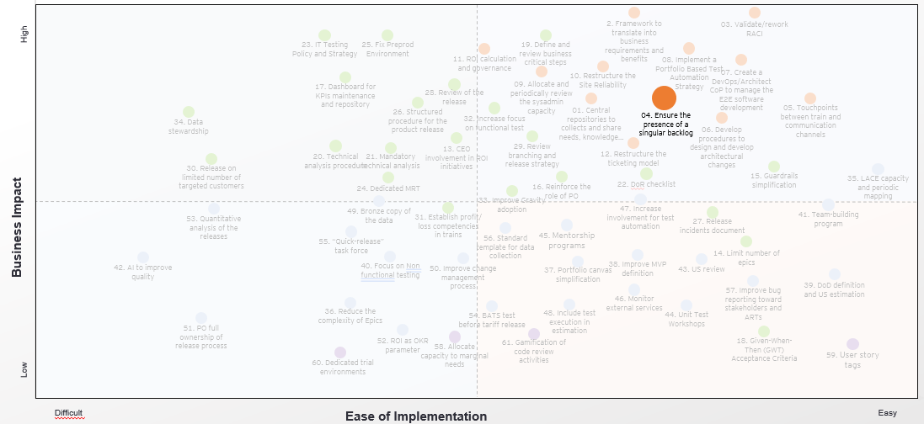
Benefit
Transparency of processes
Clarity of requirements
Single vision of a product for all the parties involved
Predictable results in terms of time, costs, and deliverables
Recommendation (4/12)
Recommendation
Define rules and restrictions that limit/avoid stakeholders to introduce features without considering the PI dynamics and timeframes. Ensure the presence of a unique backlog
Transparency of the process
&
Predictable results in terms of time, costs, and deliverables
Value chain steps
impacted
Description – Current State
Emerging priorities shift the focus from the product vision and product roadmap (e.g. requests from the Regulator, Stakeholders that bypass consolidated processes for proposing their needs and are not aligned with SAFe practices)
Presence of a variety of non-structured entry channels for needs collection compromise process solidity and established priorities
Sometimes LPM adds new Epics or features directly during the PI planning according to urgency or last-minute needs
Client needs are often collected and tracked too late, requiring change in priorities
Different community/domain managers work on parallel backlogs inside the same value stream
Execution Activities
(4.1) Identify stakeholders that usually introduce new features into Trains backlog, track existing entry channels together with their frequency and their usual timeframes. Identify among them the most impacting ones in terms of the number of related PI scope changes (or number of USP) and execute a post mortem analysis, identifying root causes and potential solutions
(4.2) Define a strict set of rules for backlog management and a limited set of channels for the entering of new requirements (as Epics or Features), clarifying specific timeframes within which new features can be added in the PI as well as the ownerships on the process. The possibility to take decisions must be guaranteed for POs and PMs, which have ownership on Trains capacity
(4.3) Define periodic Portfolio management activities for the long-term backlog planning by LPM. Ceremonies must be dedicated to the definition of value streams long-term vision and roadmap in order to plan in advance the most important activities (e.g. high-value items for the product evolution, regulatory requirements, security requirements, etc). In this way, urgent scope changes due to high priority emerging requirements should be minimized
(4.4) Implement an internal audit process to identify the presence of multiple backlogs. Carry out root cause/ postmortem analysis to document the issue and reduce the insurgence of new instances of the problem, planning remediation actions
(4.5) Define periodic LPM governance meeting to carefully monitor KPIs for PI scope changes, continuously detecting and mapping alternative needs entry channels
✓
Needs
identification &prioritization
✓
Requirement collection &
func analysis
Test plan
definition
Architectural
design
Description – Future State
Clear rules and restrictions that limit or block the stakeholders from introducing new features without considering the PI dynamics and timeframes are introduced and shared across the organization. A hard time box is established before the beginning of each PI to define which features will be included; features introduced into the backlog after the give time span are automatically shifted toward the following PI
The presence of multiple backlogs and the reasons of their existence are identified, carrying out remediation actions
Tech. analysis
& Software dev
Team env
testing &
Integ testing
Pre-delivery
testing
Metrics and KPIs
Number of scope changes per running PI
Number of scope changes USP per running PI
Scope change = increase vs decrease (+/- variation)
% of requirement OOS
% of CR over new increment requirement
#of additional requirements created to cover any gaps identified in the US/total # of US
% of US compliant with the DoR ready to be included in the Sprint Backlog during the Sprint Planning
Tools
Jira
Confluence
Lucid chart (needs/requirements diagramming, visualization)
Octane (Backlog storage, PI work organization, Epics/Features/US prioritization, POs sign-off)
Azure Devops (Backlog storage, PI work organization, Epics/Features/US prioritization, POs sign-off)
Rally (Backlog storage, PI work organization, Epics/Features/US prioritization, POs sign-off)
Key Assumptions / Considerations
Comprehensive mapping of Stakeholders and potential entering channels is fundamental, as well as a proper root cause analysis execution to identify corrective actions
An extensive training on the new solution usage and related procedures is mandatory for an effective implementation, together with a proper monitoring of the adoption level over time
Prod release & post Release
monitoring
ROI
Evaluation
Defects
monitoring

Slide 17
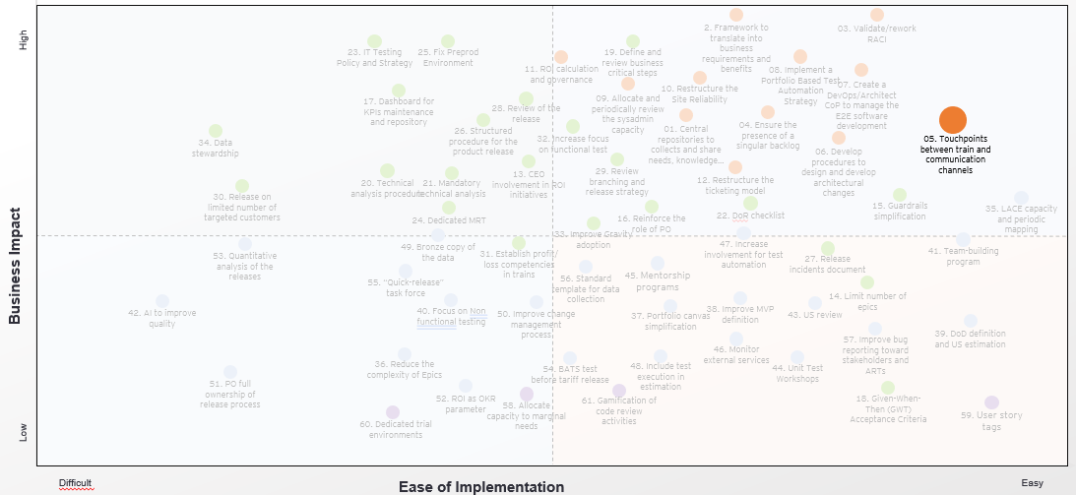
Benefit
Transparency of processes
Clarity of requirements
Single vision of a product for all the parties involved
Predictable results in terms of time, costs, and deliverables
Recommendation (5/12)
Recommendation
Establish official touchpoints among trains, teams and CoPs to create a bi-directional communication channel, share high level product vision in order to reduce frictions, remove dependencies and allow knowledge and best practices sharing
Single vision of a product for all the parties involved
Value chain steps
impacted
Description – Current State
Poor alignment on common objectives and best practices shared among release trains and teams of the same train (poor dependencies management, presence of code duplication, etc)
Some stakeholders operate outside the ART and often are not aligned with trains’ priorities
Silos structure, synergies and communication among different trains are not managed, LPM does not coordinate the work between trains, leading to silos structure
Change Management Process is not shared and is not well known by team members
Poor information sharing about incident management by the Magic Release Team
Execution Activities
(5.1) Enhance structured Agile ceremonies (scope, attendee, and timebox) by including all people/ roles interested, requiring participation and commitment
(5.2) Definition and sharing of ceremonies plan and structure: define roles/people that must attend the meeting, set meeting goals and define meeting output/document, define meetings cadence and send recurring invitation for all ceremonies e.g.:
Every two months between all stakeholders, LPM/Triads/CoP
Monthly meeting among trains/CoP/ Release Team
Every two weeks meeting among teams of the same train
(5.3) Define an ad hoc communicational channel and link a shared repository to track the output of each ceremony
(5.4) Create a Newsletter to inform all the organization people about the Change Management Process and its update, with a dedicated section for tips, best practices input, repositories links
(5.5) Set up a quarterly meeting for each train to share objectives and results, discuss about new opportunities, organize workshop
✓
Needs
identification &prioritization
✓
Requirement collection &
func analysis
✓
Test plan
definition
✓
Architectural
design
Description – Future State
Common objectives and best practices are discussed in proper meetings and documented (using a common template) in a shared repository easily accessible to all interested people in the organization
Stakeholders are involved during the sprints and aligned during dedicated meetings
The whole organization is aware of and updated about Change Management process
Dependencies and synergies are managed in dedicated meeting and tracked on Jira
Alignment takes place reducing dependencies and increasing efficiency
Formal communication channel and recurrent touch points are in place (anyone can ad topics to the meeting agenda)
✓
Tech. analysis
& Software dev
✓
Team env
testing &
Integ testing
✓
Pre-delivery
testing
Metrics and KPIs
#of actual attendees / #of expected attendees per ceremony
#of documents created / #of ceremonies
#of used communication channels
#of communication occurring out of the formal channels
Tools
Chat
Newsletters
Google Drive
Jira
Lucid chart
Miro/Mural
Key Assumptions / Considerations
An extensive training on the Agile/SAFe framework is mandatory to fully understand the communication importance and benefits, share mindset and the required commitment
Clear and specific goals of each meeting/communication channel must be shared (before) and output documented
Simplicity, recurrency and standardization are key factor in enhancing the correct use of repository, document and communication
Every meeting participant must be considered and heard
✓
Prod release & post Release
monitoring
✓
ROI
Evaluation
✓
Defects
monitoring

Slide 18
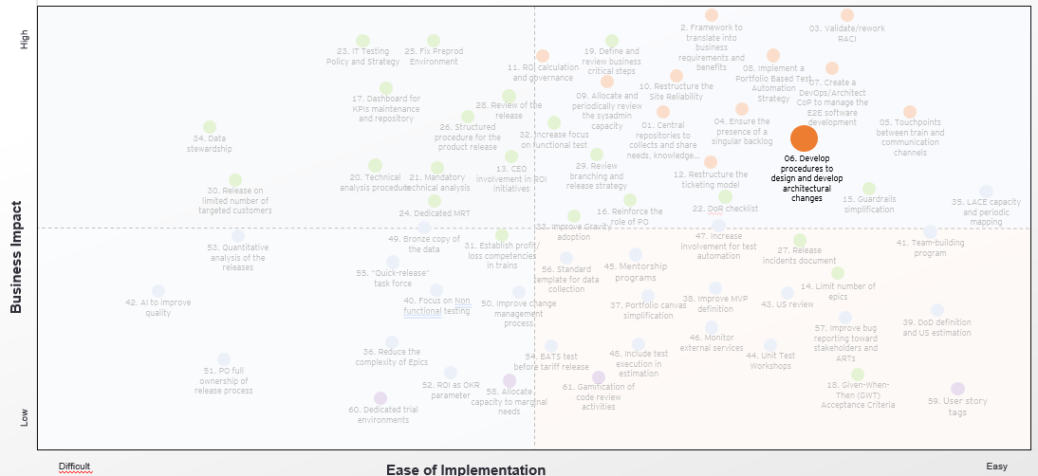
Benefit
Transparency of processes
Clarity of requirements
Single vision of a product for all the parties involved
Predictable results in terms of time, costs, and deliverables
Recommendation (6/12)
Recommendation
Develop procedures and routines for the design and development of architectural changes, using architectural boards (e.g. TOGAF). Leverage ad hoc tools like ARC42 to design architectural themes
Transparency of the process
&
Clarity of requirements
Value chain steps
impacted
Description – Current State
Lack of standardization, routines and guidelines on Process / Templates
The number of different channels utilized to communicate between trains does not allow for standardization and best practices sharing
Architectural changes approval process in place but not always followed properly
Lack of clear ownership definition allows to misalignment, uncertainty and inefficiencies
Execution Activities
(6.1) Define a standard template for Architectural change documents and diagrams, consider using Arc42 templates to enhance architectural themes design, track and document important architectural decisions
(6.2) Define a clear structure of the architectural board using TOGAF
(6.3) Set up a formal process using tools like Jira and Confluence to:
Set up and validate a formal checklist to be followed for the design and development of architectural changes
Ensure the checklist is followed and document all steps and decisions taken
(6.4) Plan training session to share the new process/ templates and how to use tools, methodology and boards
(6.5) Establish periodic meetings between architectural teams of different trains to allow for alignment, standardization and best practices sharing
(6.6) Set up periodic (e.g. each four-months) and recurring activities to review the formal process, template structure and KPIs to improve architectural design quality and performance
Needs
identification &prioritization
Requirement collection &
func analysis
Test plan
definition
✓
Architectural
design
Description – Future State
Standardized routines and processes as well as guidelines and templates across teams are in place. Design review is done across relevant teams / SMEs and architectural approval is carried out and tracked properly
Efficient use of communication channels; best practices, templates, decision frameworks and quality KPIs are shared across the whole organization to increase efficiency, avoid misunderstanding among teams and trains, and decrease eventual adaptation time when people are reallocated
Correct and effective engagement of relevant people in every step of the processes to track and maintain for future reference all decisions taken
Tech. analysis
& Software dev
Team env
testing &
Integ testing
Pre-delivery
testing
Metrics and KPIs
#of requirements approved by the Architectural board/#of total architectural requirements
#of requirements rejected by the Architectural board/#of total architectural requirements
Tools
Jira
Confluence
SPOCs
Arc42
Gliffy
Enterprise Architect
Key Assumptions / Considerations
Agile/SAfe Dev. Team ceremonies attendance is essential to guarantee transparency, standardization and increase velocity and quality in architectural changes
Formal communication channel and unique validation process across and among trains about architectural issues and changes increase velocity, quality and architectural stability
Prod release & post Release
monitoring
ROI
Evaluation
Defects
monitoring

Slide 19
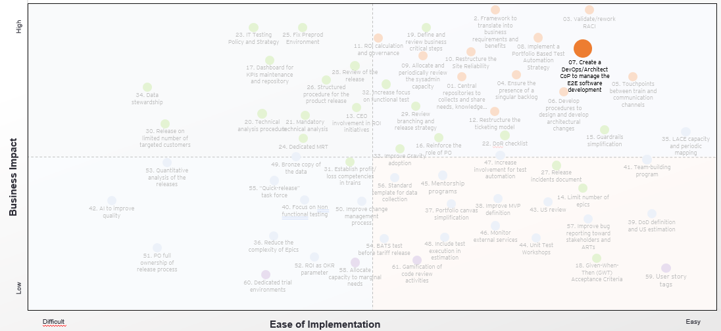
Benefit
Transparency of processes
Clarity of requirements
Single vision of a product for all the parties involved
Predictable results in terms of time, costs, and deliverables
Recommendation (7/12)
Recommendation
Create a DevOps/Architect CoP to manage the E2E software development process verifying development guidelines and technical analysis execution and establishing the new DevOps pipeline configuration and standardization
Transparency of processes
Value chain steps
impacted
Description – Current State
Lack of a full-time role dedicated to the Agile Team, with ownerships on technical analysis execution and approval, and end-to-end management of DevOps software development lifecycle pipelines (i.e. the product Architect)
A full-time architect is missing at a Train level
Technical analysis not always implemented (in particular for large scope features) and lack of ownership on technical analysis execution
Lack/limitation of specialized tools and resistance by the teams to adapt to new tools where present
Best practices like code review and pair programming are not sufficiently widespread. Lack of a repository of technical knowledge
Existing procedures and checklists not used in the day-by-day operations, some of them are applied only for auditing purposes
Poor release process standardization, impossibility to implement rollbacks
Execution Activities
(7.1) Identify the set of resources to create the DevOps/Architect CoP
(7.2) integrate into the RACI model the new DevOps/Architect CoP
(7.3) Implement dedicated training activities on SDLC practices
(7.4) Review the software development life cycle from technical analysis, to quality testing and release in production as well as main decision making and approval tasks. Define checklists and related owners
(7.5) Review pipeline configuration (the suggestion is to represent it graphically) in order to:
have an automatic quality gate after build activities
automate and versioning database scripting
have an automatic environment creation or/and configuration
implement automatic testing after installation
have an automatic rollback when there are installation problems or when the release does not achieve the required quality standard (configurable)
centralize environment management
allow POs to manage directly the release in production environment
(7.6) Implement an extensive training to onboard all interested resources on the new pipeline configuration (e.g. POs and developers)
Needs
identification &prioritization
Requirement collection &
func analysis
Test plan
definition
Architectural
design
Description – Future State
A DevOps/Architect Team is created to manages the whole end-to-end SDLC process and adopts tools of code statical analysis (e.g. Sonar) to verify that development guidelines are respected
The technical approval of developed code (i.e. code review activities) is performed by the architect which created the technical analysis
New configuration and standardization of DevOps pipelines. New rules are established and steps are set as mandatory, tools configuration is adapted to host new features and capabilities (e.g. rollbacks)
A clear procedure and a standard template for the preparation of technical analysis is in place
Mandatory tests are set along the pipeline in order to guarantee the desired quality level. Automatic tests are implemented in every infrastructure environment throughout the pipeline
✓
Tech. analysis
& Software dev
Team env
testing &
Integ testing
Pre-delivery
testing
Metrics and KPIs
Adopt metrics provided by the various software products
Adopt DevOps metrics provided by ServiceNow
Code coverage %, e.g. Jacoco reports, Sonarqube reports, Twistlock reports, Sonatype reports etc.
Velocity rate = accepted USP vs total USP
#of acceptance criteria covered with unit tests/total # of acceptance criteria
#of US closed in a sprint/#of total user stories planned
#of planned US in the Sprint/#of overall US in the Backlog (in USP)
Tools
Gitlab
Codata
Maven
Junit
Owasp
Sonar
Codenarc
Artifactory
ServiceNow
Key Assumptions / Considerations
The new pipeline configuration must be designed in order to perfectly fit with organizations process and technical characteristics, and not vice-versa. This is fundamental to achieve the desired benefits
An extensive training on the new solution usage and related procedures is mandatory for an effective implementation, together with a proper monitoring of the adoption level over time
Prod release & post Release
monitoring
Jmeter
Postman
SoapUI
Terraform
Liquibase
Ansible
Splunk
Elasticsearch
Grafana
Dynatrace
Npm
ROI
Evaluation
Defects
monitoring

Slide 20
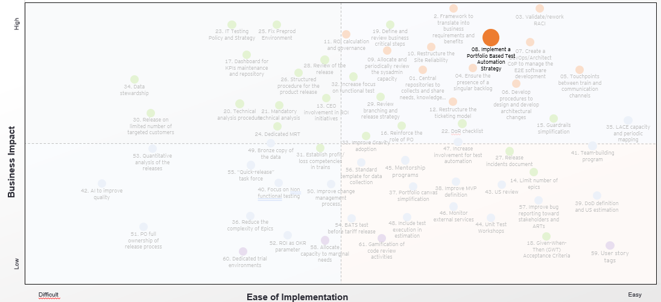
Benefit
Transparency of processes
Clarity of requirements
Single vision of a product for all the parties involved
Predictable results in terms of time, costs, and deliverables
Recommendation (8/12)
Recommendation
Implement a Portfolio Based Test Automation Strategy, including team and governance, along the whole DevOps pipeline
Transparency of the process
&
Predictable results in terms of time, costs, and deliverables
Value chain steps
impacted
Description – Current State
The knowledge regarding the CompanyAnt of the test suite is not widespread, impacting its maintenance
Test automation is not perceived as a priority to ensure product quality, due to capacity and low time allocated to this topic, skills and approach gaps are also reported
Guardrails dedicate a low percentage of estimated effort on test automation
Problems with the configuration of the environments and hardware
Execution Activities
(8.1) Define a Portfolio Based Test Automation Strategy outlining Test Automation objectives on Different Levels (adopting a Risk Based Testing approach)
(8.2) Test Automation Process should cover the selection & analysis for Test Automation candidates and a Test Automation Framework focused on implementation patterns, architecture and tools & libraries
(8.3) Review Teams and Governance (particularly for addressing skill gaps and roles & responsibilities); communicate clearly how testing will work within different teams. This step may also include team redefinition (also identify a clear resourcing strategy e.g. Hiring, Outsourcing, Staff augmentation with external SMEs)
(8.4) Plan a continuous review and maintenance of test environments and data (also implementing smoke tests between environments)
(8.5) Improve and constantly review test metrics used to monitor test
(8.6) Review and restructure the current CoPs creating a wider Testing ‘Community’, a CompanyA Testing Center of Excellence, in order to connect all QA related people and share knowledge, exchange experiences, support each other and work on testing improvements. The TCE needs to be led by a CompanyA QA Lead who hold responsibility for definition, implementation and stewardship of QA & Testing activities
(8.7) Develop automation specific ROI calculation
(8.8) Share test-vision with all team members
Needs
identification &prioritization
Requirement collection &
func analysis
✓
Test plan
definition
Architectural
design
Description – Future State
A comprehensive Portfolio Based Test Automation Strategy is in place, periodically reviewed and shared
Roles, accountabilities, ownerships, skills and knowledge are reviewed and aim toward automation. Test automation and, more widely, team inclusion in testing is widespread and effectively carried out; LPM pushes to increase test quality and test automation
Tools and libraries cover both Front End (digital, with Unit/API/Functional) and Back End (Guidewire) with gUnit, API/Functional with Self Healing component (i.e. library that can be implemented in the automation framework, improving functional test with self fixing scripts). Adoption of cloud solution and SaaS for both Front and Back End is carried out and facilitates the adoption of widespread automation. Allure is used as a single tool to report on test automation
Tech. analysis
& Software dev
✓
Team env
testing &
Integ testing
✓
Pre-delivery
testing
Metrics and KPIs
#of NRT/total test
#of non happy path/total test
#automation test/total test
Test Cases metrics (e.g. #Run TC/#overall TC, #Passed TC/#Run TC, #of test cases automated / total #of test cases, etc.)
#of E2E test/total #of tests
#of environment issues per PI
First time Pass Rate
Tools
Confluence / Jira / Octane / Zephyr (Test plan storage and execution)
TFS (Manual test plans and test suites writing and execution )
Azure Devops (Test cases storage and test management)
Selenium (regression automation suites and tests)
Jmeter (test performance both on static and dynamic resources)
gUnit/jUnit/… (unit test)
Postman (Integration test) / Loadrunner (performance test) / Copado (Test automation, NRT)
Allure (reporting on test automation)
Key Assumptions / Considerations
A bottom-up test approach is implemented (starting form Unit Testing)
Teams are actively involved in testing activities, redefining ownerships and prioritizing them
Mandatory quality checks should be implemented along the DevOps pipeline
✓
Prod release & post Release
monitoring
ROI
Evaluation
Defects
monitoring

Slide 21
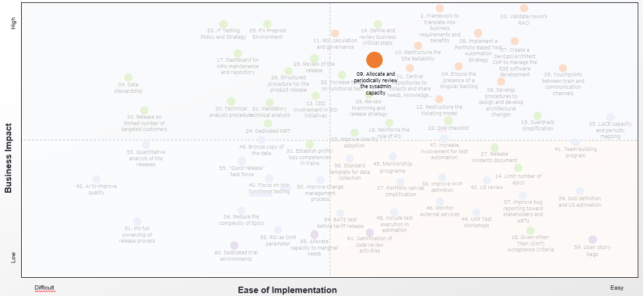
Benefit
Transparency of processes
Clarity of requirements
Single vision of a product for all the parties involved
Predictable results in terms of time, costs, and deliverables
Recommendation (9/12)
Recommendation
Allocate and periodically review the sysadmin capacity within the trains, based on previous PI needs trend, to handle the product backlog in terms of evolutions and structured maintenance. Hire junior figures and set up a plan for their training
Transparency of the process
&
Predictable results in terms of time, costs, and deliverables
Value chain steps
impacted
Description – Current State
Sysadmin CoP is understaffed and with excessive workloads, multiple support requests towards sysadmin team, shifting their focus form the train activities and leading to frustration
International resources present a lack of technical and infrastructural knowledge going back to sysadmin team for support
Lack of alignment between sysadmin and EUIGS teams
Sysadmins are effectively outside the teams, and they struggle to receive effective prioritization from POs, a silos approach is often present
Execution Activities
(9.1) Verify effective sysadmin CoP members capacity and identify the trade-off between train teams sysadmins and Site Reliability team (second level service desk squad)
(9.2) Estimate sysadmin capacity needed to manage sysadmins’ tasks within trains based on previous years time-series, considering required contingency
(9.3) Define clear responsibilities of sysadmin CoP members within train teams and make sure that they are dedicated to activities related to product backlog in terms of evolutions and structured maintenance; integrate into the RACI model the team responsibilities
(9.4) Ensure sysadmin CoP members alignment with train teams ensuring their participation in all train ceremonies/ dedicated meetings when needed
(9.5) Onboard senior and junior figures to cover the current vacancies and reinforce the community
(9.6) Design a training path dedicated to junior figures to grow necessary skills (Sys-Academy) and strengthen in the mid term the sysadmin CoP
(9.7) Create a repository and a proper communication channel with the international Site Reliability team to align on specific features when needed
(9.8) Plan periodic meetings for a high-level knowledge transfer from train to Site Reliability team and vice versa
(9.9) Review periodically the sysadmin capacity allocation within trains
Description – Future State
Sysadmin CoP members work within the train and handle development and maintenance activities, attending ceremonies and working to transform the product backlog into an increment
Direct and efficient alignment between Sysadmin CoP members, development teams and Site reliability team
✓
Tech. analysis
& Software dev
Prod release & post Release
monitoring
Requirement collection &
func analysis
Architectural
design
Team env
testing &
Integ testing
Needs
identification &prioritization
Test plan
definition
Pre-delivery
testing
ROI
Evaluation
Defects
monitoring
✓
✓
Metrics and KPIs
#of ceremonies attended by each sysadmin/ #of ceremonies for each sysadmin
#of US closed in a sprint/#of total user stories planned
Code coverage %, e.g. Jacoco reports, Sonarqube reports, Twistlock reports, Sonatype reports etc.
Velocity rate = accepted USP vs total USP
Test cases pass rate
#of defects / #of US developed
#of critical defects / #of releases
#of days to close a bug
Tools
Jira
Confluence
Jenkins/GitHub
SonarQube
Key Assumptions / Considerations
Effort to redefine (and continuously monitor and update) roles and ownerships is needed
Review skills and competencies in order not to create bottlenecks and fully support the whole train
SAFe principles and Agile framework must be in place and followed by sysadmin team
✓
✓

Slide 22
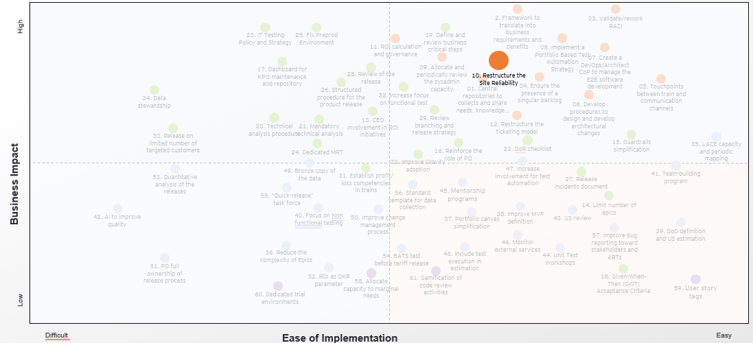
Benefit
Transparency of processes
Clarity of requirements
Single vision of a product for all the parties involved
Predictable results in terms of time, costs, and deliverables
Recommendation (10/12)
Recommendation
Restructure the Site Reliability cross country squad in terms of cross-functional skills and capacity. Redesign the Site Reliability Team processes and ownership to improve activities’ and alert monitoring, infrastructure stability & incorporate EUIGS transferred activities
Transparency of the process
&
Predictable results in terms of time, costs, and deliverables
Value chain steps
impacted
Description – Current State
Lack of sysadmin capacity allocated to production release and monitoring activities (infrastructure and environment status, alert monitoring and management)
Lack of ownership on the post release monitoring activities (e.g. a product owner for post-release activities)
Lack of clear acceptance criteria on how to monitor a certain feature in production
Lack of alignment between sysadmin and EUIGS teams
Lack of metrics for post-release and production environment inefficiencies monitoring
Execution Activities
(10.1) Split Sysadmin CoP member between trains and Site Reliability Team so that they can both effectively work on product backlog (evolution and maintenance) and manage disruption, hardening and patching cross-activities and other vulnerabilities in production, including EUGIS transferred activities
(10.2) Review and reconstruct Site Reliability cross country team in terms of both capacity and cross-functional skills, review the skill gaps and identify actions to be carried out
(10.3) Onboard ad hoc figures to cover current vacancies and reinforce the community
(10.4) Design a training path dedicated to junior figures to grow necessary skills (Sys-Academy) and strengthen in the mid term the sysadmin CoP
(10.5) Formalize the list of activities to be carried out by the Site Reliability team (e.g. incident management, monitoring, VSL management, urgent vulnerabilities, cross-train infrastructural maintenance, etc.) and clearly define ownerships, integrating it in the RACI matrix
(10.6) Establish clear metrics and processes; formalize reporting procedures to document the current state of Site Reliability cross country
(10.7) Plan periodic meetings for a high-level knowledge transfer from train to Site Reliability team and vice versa
Description – Future State
Capacity of sysadmin is allocated efficiently, knowledge and capabilities are internalized and effectively used within the organization
Reviewed Site Reliability lessens part of the “stress” on the Italian team by reviewing the roles and creating a clear and shared process; alignment between Italian team and EUIGS improved reducing frictions between both sides
Lessened post-released production environment inefficiencies
Direct and efficient alignment between development teams and Site reliability team takes place
Clear metrics are created and utilized to evaluate the performances of Site Reliability team, reporting is carried out to easily document the current state of the Site Reliability cross country
Tech. analysis
& Software dev
Prod release & post Release
monitoring
Requirement collection &
func analysis
Architectural
design
Team env
testing &
Integ testing
Needs
identification &prioritization
Test plan
definition
Pre-delivery
testing
ROI
Evaluation
Defects
monitoring
Metrics and KPIs
Sysadmin abandonment rate
#of production inefficiencies
Defect density & Defect fix rate
#of defects opened in the week/yearly (per severity, stream)
#of blocker- critical-major bugs vs total
#of days to close a bug
#of Test cases executed & #of Test cases Passed / Failed
Downtime period per day
Average resolution time
Tools
Confluence (Store documentation, plan of release with the list of delivered features)
Jira (task monitoring, tests results)
Slack (communication tools)
Octane (task monitoring)
Key Assumptions / Considerations
Effort to redefine (and continuously monitor and update) roles and ownerships is needed
Review skills and competencies in order not to create bottlenecks
✓
✓

Slide 23
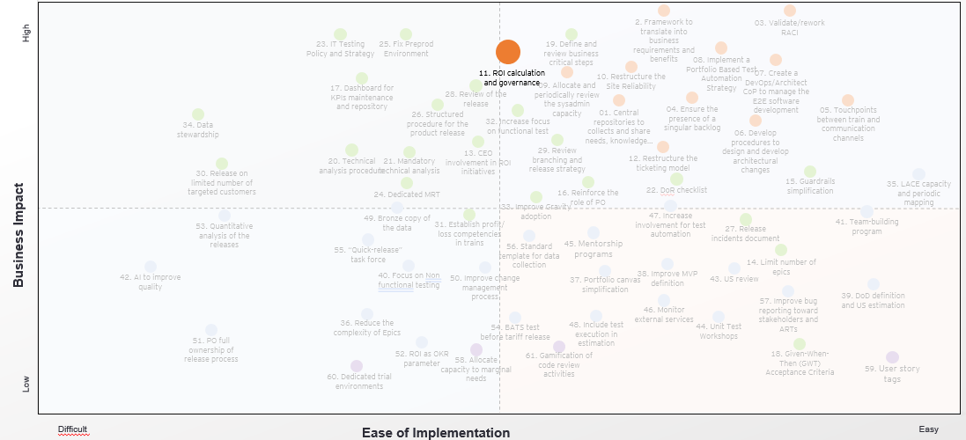
Benefit
Transparency of processes
Clarity of requirements
Single vision of a product for all the parties involved
Predictable results in terms of time, costs, and deliverables
Recommendation (11/12)
Recommendation
Establish a clear process for ROI calculation and governance, there must be a procedure to calculate ex ante and check ex post the initiative’s ROI
Transparency of the process
&
Predictable results in terms of time, costs, and deliverables
Value chain steps
impacted
Description – Current State
Lack of a formal request from leadership to create the need for ROI calculation
PM and PO have a view on benefits while Finance has the view on costs, consequently, coordination is needed to pursue ROI calculation
LPM and LACE have the high-level view to take strategic decisions based on ROI, which nowadays does not happen, currently the focus is solely on costs
Lack of a shared method /procedure to be followed by the PO for calculating the ROI
Lack of Agile PMOs who analyze Features on Jira to calculate the ROI and report it to LACE and LPM
Execution Activities
(11.1) Setup a series of meetings to identify the type of initiative (e.g. product Features) to be addressed for ROI calculation, defining the desired level of granularity. This decision must be taken involving Trains PMs and POs (i.e. the ROI calculation owners), the LPM Team and C-level company roles, which must be fully aligned with the ROI calculation purpose
(11.2) Create a cross-Train ROI Competence Team, involving professional from the Finance department as well as Agile PMOs, a new full-time Train role dedicated to support PMs in ROI calculation and reporting (hiring may be required)
(11.3) Establish rules for estimating Story Points involving end users (i.e. Teams developers) while the approach for translating them into costs must be defined with the Finance department (few-easy to calculate costs must be considered in a first phase, like labor costs). Specific workshops must be executed
(11.4) Exploit quantitative scoring for the evaluation of final customers qualitative feedbacks to estimate initiative’s benefits for ROI calculation (when applicable)
(11.5) Establish a clear process for information tracking and ROI calculation. ROI calculation should be managed by Trains PMs (with the support of the Competence Team). Schedule periodic ceremonies to collect information about benefits and costs and to execute ROI calculation (a 3 month execution would be enough in a first phase). Create shared documents to track over time benefits, costs and ROI results
(11.6) The ROI governance should be carried out by the LPM and LACE which has also decision-making responsibilities. Periodic ceremonies for monitoring ARTs’ features ROI and taking decision consequently must be scheduled
Needs
identification &prioritization
Requirement collection &
func analysis
Test plan
definition
Architectural
design
Description – Future State
The type of initiative (e.g. product Features) to be addressed for ROI calculation has been identified, defining the desired level of granularity. A unique approach to estimate Story Points and to convert them into costs (Euro) has been established and shared across organization Teams and Trains
A clear process for ROI calculation and governance is established, defining its main phases and related ownerships. ROI calculation is managed by Trains’ PMs (with the support of a Competence Team) which collect initiatives’ benefits (defined scoring) and costs
A procedure to calculate ex ante and check ex post initiative’s ROI is in place and a continuous ROI monitoring is carried out by LPM and LACE
Tech. analysis
& Software dev
Team env
testing &
Integ testing
Pre-delivery
testing
Metrics and KPIs
Earned value
Flow velocity
Flow efficiency
IT costs
Time claim creation
Time to Payments
Tools
Confluence (requirements collection, online documentation storage and link to connected tools/ platforms, POs sign-off)
Jira (Backlog storage, PI work organization, Epics/Features/US prioritization, POs sign-off)
MS Office
Key Assumptions / Considerations
Involvement of company’s top management for key ROI calculation process decision is fundamental to create an organization purpose for ROI continuous monitoring and related impact on decision making
Pursue direct involvement of the finance department in the Competence Team
Prod release & post Release
monitoring
✓
ROI
Evaluation
Defects
monitoring

Slide 24
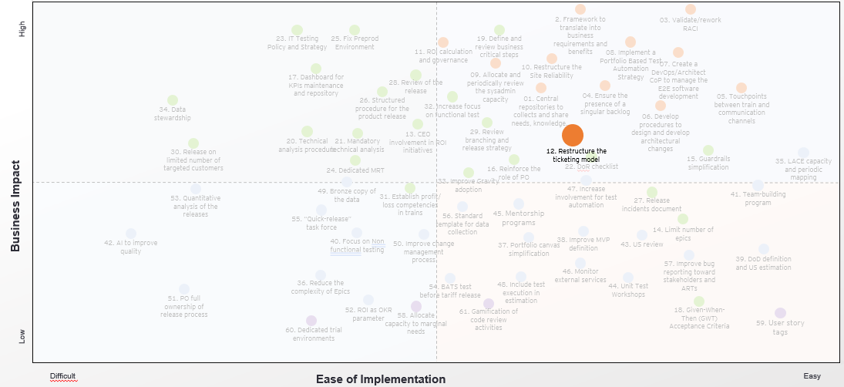
Benefit
Transparency of processes
Clarity of requirements
Single vision of a product for all the parties involved
Predictable results in terms of time, costs, and deliverables
Recommendation (12/12)
Recommendation
Restructure the ticketing model. E.g. SD and PO in charge. Daily board to showcase defects status to all stakeholders
Transparency of the process
&
Clarity of requirements
Value chain steps
impacted
Description – Current State
Difficulties in issues communication between POs and SD due to incomplete information
Lack of process ownership
Communication tools are not correctly used (Jira)
Knowledge gap and lack of accountability in EUIGS side creates difficulties in addressing issues
Post-mortem and root cause analysis are seldomly produced
Execution Activities
(12.1) Define a set of information and a standard template that both SD and POs need to provide and receive in case tickets in production arise and outline a process to manage the ticket path and its evolution monitoring, defect monitoring procedure
(12.2) Set up meetings with stakeholders to define the set of information to be included in the bugs’ monitoring report, the communication channel and the list of interested people inside the organization which should get the communication
(12.3) Carry out monthly bug reporting , trains’ Product Owners should be in charge of sharing it with all stakeholders to also guarantee functionalities’ coherence with the given requirements and correct prioritization of the bugs in the backlog
(12.4) Utilize Dynatrace (or other monitoring tools) to improve monitoring and incident management process, explicitly including it inside the defect monitoring procedure. Monitor the tools daily and promptly address issues emerging in production
(12.5) Utilize shared repository to store post-mortem and root-causes analysis documents to link to Jira in order to easily identify if the same disruption previously happened in production. This should allow local and EUIGS team to effectively investigate the issue root causes and help to solve the problem. The document production and consultation must be a mandatory step of the defects’ monitoring procedure
Description – Future State
Clear communication takes place between SD and POs and the parties have a clear understanding of the information that need to be shared in case of tickets arising in production. A clear process to manage the ticket is shared between SD and POs
Stakeholders are frequently involved and consulted as a source of input for monitoring reports; bugs reports are regularly shared to POs which are in charge of the prioritization of the bugs into the backlog
Improved effectiveness of tools (e.g. Dynatrace) with further creation of a repository of post-mortem and root causes analysis to facilitate the resolution of “recurrent” disruptions
Tech. analysis
& Software dev
Prod release & post Release
monitoring
Requirement collection &
func analysis
Architectural
design
Team env
testing &
Integ testing
Needs
identification &prioritization
Test plan
definition
Pre-delivery
testing
ROI
Evaluation
Defects
monitoring
Metrics and KPIs
Defect density
Defect fix rate
#of defects opened in the week/yearly (per severity, stream)
#of blocker- critical-major bugs vs total
#of days to close a bug
#of defect closed / # number of defect within a month
#of regression defects opened / total number of defects opened
#of defects resolved, #of defects still Open
Tools
Confluence (Store documentation, plan of release with the list of delivered features)
Jira (task monitoring, tests results)
Slack (communication tools)
Octane (task monitoring, tests results)
Key Assumptions / Considerations
Continuous alignment between trains’ POs takes place to ensure both figures are committed to the process and are carrying out the activities they are accountable for
✓

Slide 25
How to be ahead of the Market

Slide 26
1 - Nexus for Insurance

Slide 27



EY Nexus is a platform built to solve today’s complex challenges while positioning you for the future
FS industry solutions
Assembled solutions which are easily adapted, quick to configure and designed to address many of today's complex challenges faced by Insurance companies
Reusable platform
tools, accelerators and utilities
Industrialized cloud-ready components, tools, accelerators and utilities which are the foundation of every technology project and allow you to reduce speed to market and cost of your implementations
FS industry solutions
EY Nexus
CompanyAmporary ecosystem of partners
Future-proof your technology implementations by leveraging the broad set of capabilities available today and refreshed in the future from next generation core providers, InsurTechs and the EY alliance ecosystem - all available in the cloud (client premises, EY cloud or as a managed service)
Reusable platform
tools, accelerators and utilities
CompanyAmporary ecosystem of partners
Assembled NOT Built | Months NOT Years | Modernized NOT Legacy

Slide 28



Nexus solutions address complex Insurance industry challenges by leveraging and orchestrating ecosystem capabilities
1. NEXUS LAUNCH
Launch innovative insurance products, brands and marketplaces
2. NEXUS EXPERIENCE
Improve Customer, Partner and Associate experiences
3. NEXUS OPERATE
Improve efficiency by digitizing operations
4. NEXUS MODERNIZE
Progressively modernize technology systems
Leverage an ecosystem of technology partners and pre-built library of components unlocking new revenue opportunities in the market. This is done while significantly decreasing timeframes for market launch and reducing cost of ownership
Leveraging hyper-personalization and data aware CompanyAxt to digitize the experience for customers, partners and associates providing better customer intimacy and associate engagement
Digitizing and transforming operations at speed and scale, leveraging capabilities present in the ecosystem and applying automation and advanced data techniques (AI, ML, NLP, etc …)
Leveraging existing or modern core platforms wrapped by low-code / no-code digital front end with a micro-services-based business integration layer, enabling incremental modernization of technology systems

Slide 29
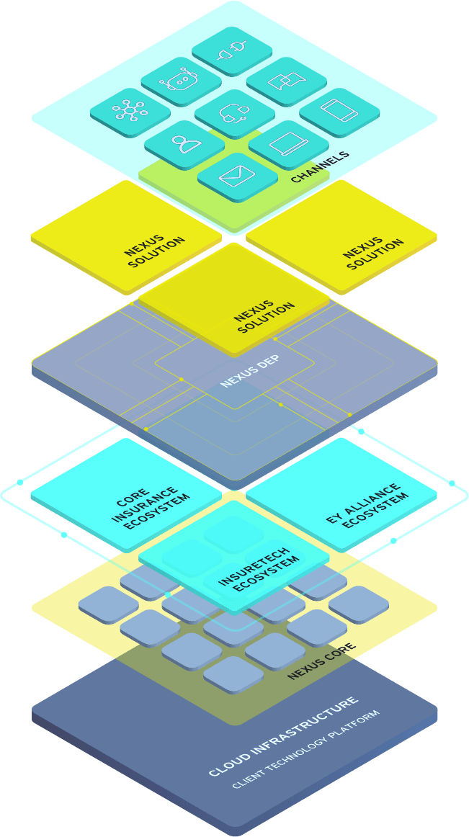
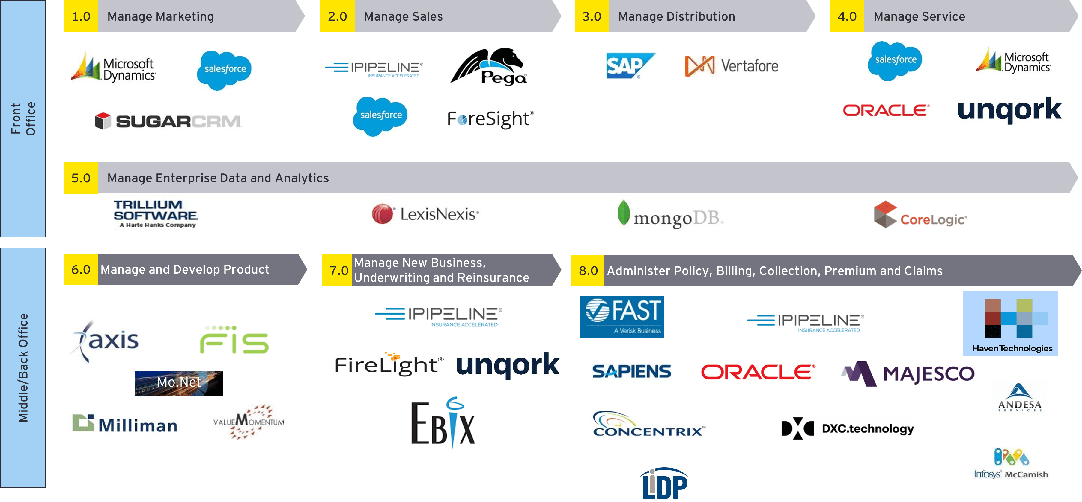
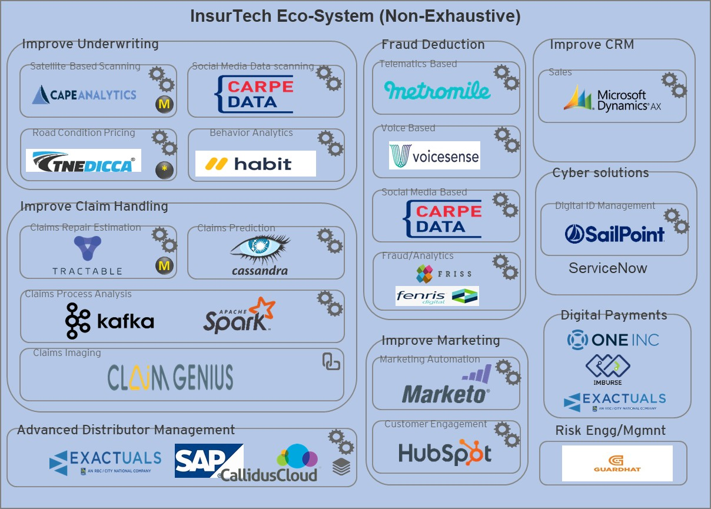
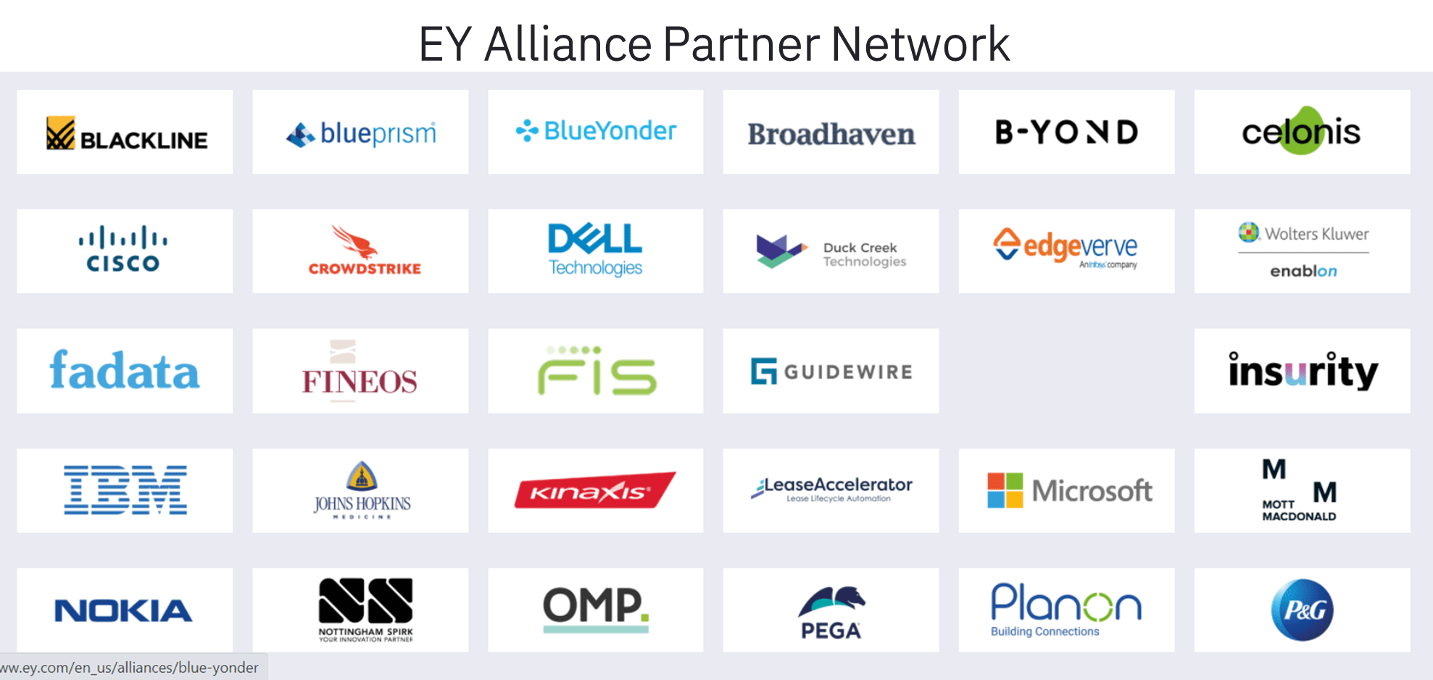
The Nexus platform has been built take advantage of the rapidly expanding Insurance ecosystem
The EY Nexus Platform
We leverage the “Power of 3” to build our platform and solutions bringing proven technology providers into the foundation of our platform and solutions.
These include:
Core Insurance Platforms – Deep expertise with core Insurance technology providers where we have led 250+ core modernization projects over the past decade for carriers of all sizes around the globe
InsurTechs – Growing landscape of specialized technology players and business models where we have evaluated 1400+ providers and will continue to grow our database
EY Alliances – Our award-winning program which provides EY with unparalleled capabilities with the worlds leading providers of technology
Core insurance technology platforms (Non-Exhaustive)

Slide 30
Ready solutions/POC we can demo Today
Nexus AUTO
Nexus NextGen Claims
Nexus Pet Insurance
Nexus SME
Nexus CSA Portal
Nexus Workers Comp
Auto product for the millennials
Customer portals and apps, Call centre agent support
Policy servicing
Telematics – rewards program based on driving history
Re—platforming core claims processes
Prefilled FNOL, notifications, Collision detection
Repairs and towing functionalities
Total loss demonstration
Pet Insurance reimagined
Nexus test and learn approach
Quote and Buy, account management
Integration with google analytics
Quote and Buy journey for business owners
Business interruption and loss of money product lines
Responsive web design and a scalable architecture to add more products with ease
Help customer service representatives of carriers to provide a better customer experience around Quote, Policy Servicing, Endorsement and Cancellations over a phone call.
Workers compensation Quote and Buy Flow
Integration with Experion
Pay as you go for employee records
Nexus Renters Insurance
Nexus Agent Portal
Nexus Carbon Offset
Nexus BANCA
Nexus IIP
Nexus Underwriting
Workbench
Quote and Buy journey for renters insurance
Responsive web design
Integration with google analytics
Agent dashboard to help with day—day activities
Customer 360 view
Insights on cross—sell for customer
Chat bots
Integration with ServiceNow
Quote and buy journey for an auto product
Ability to offset vehicle carbon emissions via personal auto policy
Data Sharing to provide carbon neutrality
Customer segmentation and insights
Customer 360 degree view for a relationship manager
Product recommendations
Quote and Buy journey
Business insights to insurers
Unified insurance data model based on Acord
Real time visualisation of KPIs on Ops, Sales, Finance etc.
Automate underwriting and risk profiling
Improve UW experience
Improve UW productivity
Improve UW decisions
Improve UW effectiveness
Nexus Group Benefits
Nexus Accident Health
Nexus HOPE
Nexus SAIL
Nexus Microinsurance
AURORA
Marketing and awareness
Employer quoting and sales set up
Sign master contract and group set up
Employee enrolment
Offering selections
Direct to consumer supplementary insurance product sold through an affinity channel
Sales Experience​
Self Service Experience​
Claims Experience
Health Offering Platform and Enablers​
Health & Wellness integration​
Find a doctor​
Customer profile based product suggestion​
Selfie based underwritin
Simplified Accelerated Insurance for Life​
Digital UI for Life product through Multi Mainframe orchestration​
Integration with Facial Analytics and Electronic Health records​​
The personal accident plan enables young professionals to flexibly build up their insurance coverage from as little as $0.3 through their daily routines
Ability to run effective digital marketing campaigns, events and promotions
Product performance specific dashboards
Recommending Solution for metric improvisation
P&C, Speciality
Product Underwriting and Pricing
Policy Administration and Servicing
Life and Annuity
Marketing and Distribution
Claims Management

Slide 31
Core Asset To Nexus Is A Catalog Of resuable APIs enabled by DEP
Customer
Lead/CRM Services
Account Services
Cognitive features like facial API, Natural Language processing APIs
Growing ecosystem of PAS and Service providers
50
Microservices
350+
API’s
Policy and Claims
Auto, Pet, Renters, Life, Group Benefits Quote and Buy flow
Policy Lifecycle Services
Renewal Batches
Invoice & Payment Services, Wallet Service
Legacy Modernization
FNOL Services
STP Claim processing
Automated Health Insurance Claim Processing CCM
PAS Integrations
EY Insurance Nexus
SOCOTRA
FADATA
Data and Analytics
Insurance Insights Platform
Data Archival
Data Transformation and Export
EIS
Guidewire
Authentication and Authorization Services
Captcha Service
3rd Party Integrations
Security
twilio | experian | Chase Paymentech
Lapetus | Damoov | PAI Health
Imburse | EasyOFAC | Claim GENIUS
Cape Analytics | ACORD | GTSoftware
Microblink | TransUnion | Smartystreets
MS Dynamics | Friss | Docu-sign
Verisk
Batch Applications
System Services
Notification Services
Address Standardization Driver Risk, Policy Risk, Credit Check, Auto Damage Estimates, Digital Payments, Digital Signatures
Batch for LIMRA transformation for Group Benefits Enrolment
Life and Annuity API catalogue in ACORD standards
Systems/ Enterprise Application Services
Activity Workflow
Ticket Services ,Agent Onboarding ,Supervisor Onboarding, Agent Termination, Supervisor Termination
Document generation like Proposal, Brochure Master Card generation
Adobe e-sign Functionalities
Agent and Ticketing

Slide 32
2 - Look at Insurtechs

Slide 33

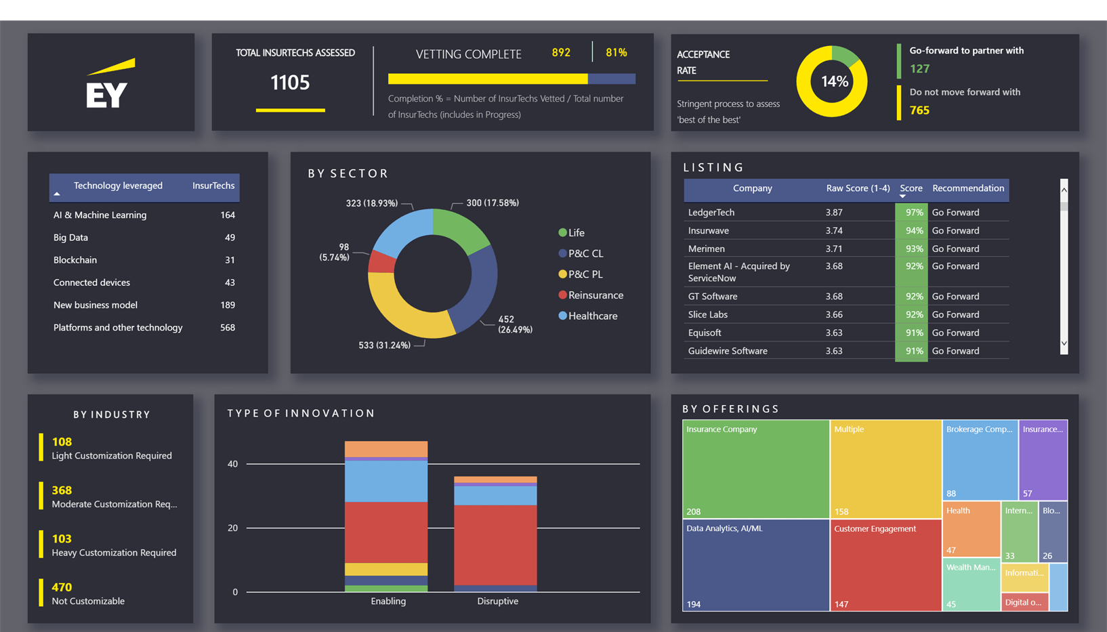


We have vetted over 1400 InsurTechs and the list continues to grow
Our InsurTech database and capability assessment matches the pace of the evolving market, and supports our clients in evaluating the value propositions of potential vendors or growth targets
Proprietary framework to assess InsurTechs offerings
EY’s capability assessment process facilitates an understanding of market fit, operating models, and technology diligence
Existing database with InsurTechs capabilities
The EY team has curated a digital ecosystem of over 1,400 technology partners across the insurance landscape
Diverse set of InsurTechs assessed
The ecosystem includes technology partners across the full value chain, from sales and marketing to claims to underwriting

Slide 34
This allows us to quickly pinpoint the right vendor for the right purpose
Review the InsurTech’s product offering focusing on the functional completeness and technology progressiveness, stability and scalability for inclusion in a digital ecosystem, or layered on top of a client’s existing landscape
Evaluate the InsurTech’s product offering and business model across the broader insurance marketplace; positive/negative reviews from analysts and customers and partners. Evaluate product against competitors
Digital Enablement
Evaluating Market Fit
D
E
Assess the InsurTech’s solution(s) relevance to P&C, Group Benefits and Life & Annuities customers across their business and IT operations
InsurTech Evaluation Framework
Review InsurTech’s management team/stability, investor profiles and commitment, InsurTech’s go-to-market and operating models
Insurance Capabilities
I
D
E
A
I
Analyze
Operations
A
Only a select number of InsurTechs make it past our business and technical due diligence, and are considered for inclusion into Insurance Offering(s) and / or Alliance

Slide 35
3 - Test automation

Slide 36
Achieving Quality@Speed
Shifting left test types
Increased emphasis on unit, component and service layer tests
Continuous testing
Leverage test automation for ‘checking’ and exploratory methods for ‘testing’
Specification-based testing
Testing of executable specifications, requirements and architecture through BDD
“Shift left” model
Traditional quality model
Early lifecycle defect detection = cost optimisation
Requirements, Design, Development
Testing, Integration, Production

Slide 37
Transforming Test Automation
Test Automation Strategy
Core Test Scripts
Focus on what matters by generating complete sets of detailed and ready test scripts with possible combinations of optimised test conditions
Data Performance Test
Data generated using Selenium REST/API JMeter scripts for large volume of data generation for integration testing
EY Performance Test Automation
Java based performance accelerator designed to perform early load test functional behaviour and measure performance early
The Test Automation Strategy is based upon these principles
Technology agnostic
Integrated testing tools for functional and performance testing
ETL, conversion and data transformation enabled
Automation break-even during development phase to generate significant ROI during stabilisation and rollout
Test Data Generator
Hexawise Pairwise
EY PTF
Automated Data Integration Testing
Python based test automation tool, capable of automating the ETL workflow
Self Healing Automation
EY’s proprietary solution for addressing the #1 cause of test automation script maintenance object changes!
EY DataValidator
EY Self Healing
Enabling human centricity
EY Configured ALM Tool for Defect Mgmt. & Reporting
English-like tests connecting business language into automated test scripts and enhance collaboration
Automate the ‘checks’ to focus humans on mitigating risk
Joint IT and Business at the heart of the Quality Engineering function
Jenkins CI/CD/CT
Desktop
EY TAF Unit Level/ Mid-layer/UI
Automated Build Quality Verification
Using Jenkins plugins to support automated building and deploying projects and kick start build verification scripts
Test & Environment Automation
Used to automate legacy screen, native desktop applications testing and creating of test environment and configuration
Continual innovation
Test Automation
EY TAF accelerator expedites test automation from pre-built, core test scripts. Using Behaviour Driven Development (BDD) method collaboration is maximised amongst business users
Self-healing and self-generation test automation scripts
Advanced testing methods simplified and converged for maximum investment return
Diverse automation tool portfolio maximising technology stack coverage

Slide 38
Behavior driven development
Dev
►Develop and configure functionality
►Automated Unit Test & ISBTF Framework
►Functional Test (System/Integration and UI-
Dev
QA
BA
level) Automation
Design
Develop
QA
►Manual Functional Tests (System and (early)
Product Backing
system integration tests)
Elaboration of the user story, definition of requirements
Agree user story acceptance criteria in BDD format
Specification by Example (Static Test)
Verification
Definition of Done
Scrum Cycle
Accept
Ready for test
PO
BA
QA
Dev
Demo
Test
Validation
Security Testing
Performance Testing
Story Acceptance Testing
Defects
QA
QA
Continuous integration
Automated regression testing

Slide 39
Behavior driven development
1
Adaptation
BDD scenarios can be easily updated as product changes. Simple language is easy to edit. Modular design makes code changes safer
2
Cooperation
Fruit of the cooperation between business, testing team and developers are scenarios which, depending on who reads them, can be:
test cases for a manual tester
scripts for the automation tester
acceptance criteria for the developer
documentation for stakeholders
3
Transparency
4
Simplicity
BDD tools make it easy to turn your scenarios into automated tests. The steps are already given in the scenarios - the automation tester just needs to write a method to perform the operation on each step
5
Adaptation
Given-When-Then steps can be reused between scenarios. The basic implementation for each step does not change. Automation code becomes very modular. Additionally, Scenario Steps can be parameterized to make them even more reusable

Slide 40
4 - Clarify roles & responsibilities

Slide 41
Unclear roles and responsibilities result in comments like these …
“I don’t know what to do here.”
“I don’t know who to go to for approval.”
“I only find out after it’s too late.”
“I thought he was meant to do that.”
“No one is willing to make a decision.”
“I could help but no one asks me.”
“I can do the job, but don’t have the authority.”
“Things are slipping through the cracks.”
“I am doing work that is part of someone else’s job.”

Slide 42
Overview of RACI
The RACI is used to understand, establish and communicate roles and responsibilities
CURRENT
It is used to understand who does what in a process
FUTURE
It is used to agree and communicate who should do what in a process
RESPONSIBLE
CONSULTED
ACCOUNTABLE
RESPONSIBLE
“The person who has to make something happen or actually do it.” - The Doer!
“Must always be consulted before a decision or action is taken - a two-way process.”
“The person who makes the final decision and has ultimate ownership. (the one who carries the can if all goes wrong).” The Buck Stops Here!
“Must always be informed after a decision or action has been taken.”

Slide 43
Functional roles
A position assigned or assumed to accomplish an activity
BUSINESS
PROCESS
Building a RACI chart with the team can help to identify issues and create buy-in to the improvements
Guidelines for developing a RACI chart
There can only be one person accountable for a task or activity
Authority (over the process/activity) must accompany accountability – empower people to act
Someone must be responsible to perform the task.
Place accountability (A) and responsibility (R) at the lowest possible level. Otherwise, the analysis of who does what may be too vague (e.g., the CEO is accountable for everything!)
Minimize the number of people consulted (C) and informed (I) to those who need to know and/or are impacted by the activity or change
All roles and responsibilities must be documented and communicated
Role 1
Role 2
Role 3
Role 4
Role 5
Activity A
A
C
R
R
Activities
An action or decision that is one of several sequential steps in the completion of a process
Activity B
C
R
R
I
Activity C
A
R
Activity D
C
A
I
Activity E
R
I
A
A = Accountable R = Responsible I = Informed C = Consulted

Slide 44
Annex

Slide 45
Roadmap Recommendations
ID | Name | Recommendations | Priority rating
01 | Set up a platform/central repository | Set up and maintenance of a platform to collect all the needs emerging from different sources (e.g. UX, Complaints, Marketing, etc.) into a “single voice of the customers”. Elaborate all collected needs to convert them into a refined and precise “need of the customer” that reflects the actual necessities of the end users. Track the “need of the costumer” through comprehensive documentation to have an overall view of needs that emerge through the platform Utilize the repository/ dashboard of metrics and structured data to carry out post backtestings of Features (a sort of post-mortem analysis), in order to connect the needs identification & prioritization process to the ROI evaluation step of the value chain Leverage a tool which works as a common repository to map all useful technologies available within the company. The repository should be shared across different Teams, Trains and even countries (e.g. Confluence, BookStack and also SPOCs for specific crucial technologies) Develop a common repository (e.g. Confluence) for the sharing of technical knowledge and best practices about architectures available technologies and programming frameworks (e.g. procedures like roadmaps for technologies adoption). To do this, Confluence can be enriched with Gliffy/LucidChart or Enterprise Architect repository. The repository should be shared across different Teams, Trains and even countries Create a log/ repository of documents for post-mortem and root-causes analysis to link to Jira in order to easily identify if the same disruption previously happened in production. This should allow local and EUIGS team to effectively investigate the issue root causes and help to stably solve the problem. The document production and consultation must become mandatory steps of the defects’ monitoring procedure Create an internal repository where all the tests (automatic and manual) can be stored, easily accessed and consulted by everyone involved in the process. This repository of tests should serve as benchmark for all future projects. Incentivize the use of the tool and plan the continuous update of the platform | Must have
02 | Translate qualitative needs into business requirements | Set up a method to evaluate the potential economic benefit of the qualitative needs converted into a score for each need, involving specific subject experts. The score should be as standardizable as possible in order be applied to the various needs that are identified by different sources (e.g. UX, Complaints, Marketing, etc.) Centralization of benchmarking activities in a single dashboard to optimize the diffusion of standardize best practices and benchmarks. Establish periodic market analyses to benchmark CompanyA’s position against competitors Adoption of software that, using technologies like AI or ML, allows for an easily collect and evaluate (quantitatively) client needs expressed through multiple informal channels | Must have
1
2

Slide 46
Roadmap Recommendations
ID | Name | Recommendations | Priority rating
03 | Validate/review RACI | Organize a meeting in which all the involved roles would review and redesign the existing RACI matrix to clearly identify roles and accountabilities, reducing overlaps and addressing ownership issues. Schedule recurring occasions for sharing updated and modalities. Review in particular PM engagement, which may directly or indirectly discourage the role of the PO Define the role responsible to guarantee the adoption and actual effectiveness of the matrix (LPM with guidance from LACE over SAFe practices and roles) Comprehensive evaluation of roles and related competences, to better understand the range of skills they should cover (e.g. the tasks of the Scrum Master role should be reviewed). The SFIA 8 framework is suggested as a reference for the digital skills competences. Identified competences should be tracked and shared in a competence matrix Once specific skill gaps have been identified, plan and execute gap-specific training, organized either internally, if specific competencies are available, or selecting external providers New roles may be required in order to cover the whole range of skills identified in the competence matrix. Design specific roles (i.e. intermediate roles) to be dedicated to solutions scouting and assign capacity to accomplish that work Assure that critical roles are continuously covered with internal figures that have received specialized and cross training. Accelerated funnel for recruiting by hiring junior figures to cover less qualified roles. Review the “job description” to make sure that the same person will not cover more than two roles in the organization Invest on specialized training to develop internal skills and create occasions to apply them on the day-by-day; plan extensive SAFe training across the organization, involving all roles directly or indirectly part of SAFe processes with LPM and LACE supervision. Focus on PO roles and responsibilities. Train POs about their primary role in the team and in guaranteeing the product quality even after the release in production Improve the retrospective process reinforcing agile coaching across the organization. Conduct an assessment to deep dive on the level of Agile adoption by organization’s Agile Teams and provide specific Agile Coaching to team members showing lower results. Provide also specific coaching to Scrum Masters of Teams with a weak Agile implementation (e.g. they do not implement a good retrospective process). Conduct periodic confirmation assessment to verify progresses Create an ad-hoc training program for all ARTs members to deep dive on current company technologies and architecture. Dedicate some capacity for experimenting existing technologies, fostering a learning-by-doing or trial-and-error approach Define roles and accountabilities regarding data/reports creation and their maintenance frequency, set up a process through which data owners provide and update data in the systems | Must have
04 | Ensure the presence of a singular backlog | Define clear rules and restrictions that limit or block the stakeholders from introducing new Features without considering the PI dynamics and timeframes. Ideally, a hard time box should be established before the beginning of each PI to define which Features will be included; Features introduced into the backlog after the give time span will be automatically shifted toward the following PI Introduce an Internal audit process to identify the presence of multiple backlogs, identify the reason and carry out remediations where possible. After they are addressed, create root cause/ postmortem analysis to document the issue and reduce the insurgence of new instances of the problem Inclusion of external stakeholders who do not adhere to Agile practices into SAFe ceremonies allows for easier communication that may help to reduce misalignment and creation of parallel backlogs Align the long-term vision through guardrails and promote the Inspect and Adapt (I&A) event to evaluate solutions and identify improvements | Must have
3
4

Slide 47
Roadmap Recommendations
ID | Name | Recommendations | Priority rating
05 | Establish communication channels and Touchpoints between trains | Establish ceremonies between trains and CoPs to create a bi-directional communication channel and share high level product vision in order to reduce frictions and remove as many dependencies as possible. The alignment must also impact the reduction of parallel backlogs Establish periodic touchpoints involving all Agile Teams, at least one for every increment (e.g. during the inspect and adapt moment). The touchpoint owner should change at every event, rotating among the various Teams. Touchpoints should aim at increasing the relationship among Teams favoring Team building, showcasing increment programming highlights, discuss ways of working and identify common and shared improvement actions Introduce dependency management ceremonies which should involve at least POs, BAs and SMs, should be carried out cross train and have a frequent cadence both pre- and during the PIs. Furthermore, a high level internal “audit” should be carried out (by the LPM) to control and address the presence of dependencies The definition of a long-term vision should not be “delegated” to the single PO but should instead be defined at high level, with LPM defining the priorities. Introduce a meeting to discuss and motivate medium- and long-term decisions Add contingency periods (especially for tech communities) allowing to reduce the workload and focus on scouting for new solutions, thus creating a technologic and strategic long-term vision Plan ceremonies/ sessions of brainstorming and analysis within the team to identify bottom-up solutions regarding Epics/ Features that may emerge from the team itself (e.g. strengthen the retrospective | Must have
06 | Define procedures to design and develop architectural changes | Develop clear procedures and routines for the design and the development of architectural changes, clarifying ownerships and interactions within the same Team as well as cross Teams and Trains (when required). The procedure should specify also how to manage urgent requests that may unexpectedly change priorities. Share these procedures with all people involved among the organization and train them. Make procedures and routines easily available in a shared repository e.g Architecture Board from TOGAF and leveraging ad hoc tools like Arc42 to design architectural themes. Ownership of architecture is a key element, according to TOGAF framework Lead Architect reports to CIO. Lead architects must be able to influence the organization, easily getting the buy-in of other stakeholders. For this reason, the Architects approval of Epics, Features and User Stories and related technical analysis should be part of the organization Definition of Ready, i.e. it should always mandatory. Moreover, an Architecture Board meeting is recommended to discuss core design decisions and approve technical architectural feasibility of Epics and Features. All Lead Architects of the various Trains should participate to this meeting After developing a strong procedure, guarantee the process governance as well. To achieve this, a clear checklist must be created to increase the governance and the quality of the process. A role (e.g. the QA) should be responsible to control if procedures and templates are followed (e.g. if the approval process have been completed) being the owner of the designed checklist Set up a dedicated recurrent meeting to share successes with other Teams, discuss progresses made on architectural related topics (e.g. Architecture Principles, Design Patterns, Clean code good practices, Reusable components, Logging standards), consolidate the community and make it grow. The meeting should involve also roles dedicated to technologies scouting. The meeting should take place during the architectural design phase, as well as at the end of the development phase, once results are achieved | Must have
5
6

Slide 48
Roadmap Recommendations
ID | Name | Recommendations | Priority rating
07 | Create a DevOps/Architect CoP to manage the E2E software development | Create a DevOps/Architect Team which manages the whole end-to-end SDLC process and adopts tool of code statical analysis (e.g. Sonar) to verify that development guidelines are respected. DevOps and Architects must use a set of KPIs to improve the quality of the release. The technical approval of developed code (i.e. code review activities) must be performed by the architect which created the technical analysis Define a pipeline automation clear target state, establish a roadmap and plan a timeline to achieve the structured changes and monitor the process; set up guardrails that ensure investments, infrastructure and maintenance are dedicated to the DevOps pipeline automation New configuration and standardization of DevOps pipelines. New rules must be established and steps must be set as mandatory, tools configuration must be adapted to host new Features and capabilities (e.g. rollbacks) Set mandatory tests along the pipeline in order to guarantee the desired quality level. Implement automatic tests in every infrastructure environment. Once development activities have been completed and reviewed, architects should involve the quality Team for the definition of post-development tests. Those tests should be automatized throughout the pipeline Establish a KPI for the unit testing pass rate required to allow the Feature/ user story final release. Include this KPI in the DevOps pipeline as a mandatory requirement for the build Launch an extensive training program across the organization the whole software development ecosystem. The training program should foresee periodic updates for all interested resources as well as skills confirmation exams | Must have
08 | Implement a Portfolio Based Test Automation Strategy | Define a Portfolio Based Test Automation Strategy outlining Test Automation objectives on Different Levels (adopting a Risk Based Testing approach). Test Automation Process should also cover the Selection & Analysis for Test Automation Candidates (including Test Automation Planning, Test Automation Design - Peer Reviews, Testing & Refactoring and Test Execution & Reporting) and a Test Automation Framework focused on Implementation Patterns, Architecture and Tools & Libraries. Plan meetings with automation experts to review and update candidate test to be automatized Create uniformity in the Test Automation Framework, focused on Implementation Patterns, Architecture, Tools & Libraries. Tools and libraries have to cover Front End (digital, with Unit/API/Functional) and Back End (Guidewire) with gUnit, API/Functional with Self Healing component (i.e. library that can be implemented in the automation framework, improving functional test with self fixing scripts) Set mandatory tests along the pipeline in order to guarantee the desired quality level. Establish a Portfolio Based Test Automation Strategy which allows to Implement automatic tests in every infrastructure environment throughout the DevOps pipeline 'Establish a CompanyA “Testing Center of Excellence” (TCE) led by a CompanyA QA Lead role created ad hoc as part of the TCE. Review and restructure the current CoPs to create a wider Testing ‘Community’, to connect all QA related people and share knowledge, exchange experiences, support each other and work on test improvements Share test-related functional vision with all team members. Test strategy must also include team redefinition and roles balancing. A resourcing strategy must be defined as well (e.g. Hiring, Outsourcing, Staff augmentation with external SMEs working with/under CompanyA supervision to provide specific automation skills). The Portfolio Based Test Automation Strategy should also emphasize the review and redefinition of the test Governance Define a clear metric to measure test automation coverage to be leveraged in order to push more towards test automation. Plan ceremonies to review and update metrics on a regular basis Create of a feasibility study to integrate tools (e.g. BrowserStack, Lambdatest-Katalon) in order to improve the automation testing currently in place. Once a tool is selected, Compatibility Testing should be included as part of overall Testing Statregy Adoption of cloud solution and SaaS for both Front and Back End may facilitate the adoption of widespread automation (e.g. AWS being on cloud) | Must have
7
8

Slide 49
Roadmap Recommendations
ID | Name | Recommendations | Priority rating
09 | Allocate and periodically review the sysadmin capacity | Allocate and periodically review the sysadmin capacity within the trains, based on previous PI needs trend, to handle the product backlog in terms of evolutions and structured maintenance. Hire junior figures and set up a plan for their training. Sysadmin CoP member should be split between trains and Site Reliability Team so that they can both effectively transform product backlog (evolution and maintenance) in an increment and manage disruption, hardening and patching cross-activities, other vulnerabilities in production, incorporating EUGIS transferred activities Increase the effective number of sysadmins based on the trains’ needs, adopting an accelerated funnel for recruiting. Hiring junior figures and setting up a plan for their training and growth inside the organization is a market best practice Plan and allocate sysadmin capacity for EUIGS support based on previous PIs’ needs, define the kind of support that needs to be given and provide the CoP with required capabilities | Must have
10 | Restructure the Site Reliability | Restructure the Site reliability cross country (IT-ES) squad in terms of cross-functional skills and capacity. Redesign the Reliability Team processes and ownership to improve monitoring activities and to incorporate EUIGS transferred activities Allocate and periodically review the sysadmin capacity within the trains, based on previous PI needs trend, to handle the product backlog in terms of evolutions and structured maintenance. Hire junior figures and set up a plan for their training. | Must have
11 | ROI calculation and governance | Identify a standard and shared approach to measure initiatives benefits across Teams and Trains. PMs and POs should be able to pitch their initiatives in front of LPM Team presenting their implementation benefits in terms of expected additional revenues/costs savings Identify the type of initiative (e.g. product Features) to be addressed for ROI calculation, defining the desired level of granularity. The initiatives should not be too large (i.e. requiring multiple Teams or Increments to be implemented) making too complex costs collection, nor too small (i.e. a few man days US or a single tasks) making ROI calculation unworthy, it should be decided involving Trains PMs, the LPM Team and the company’s top management, which must be aligned on ROI calculation purpose Establish a clear process for ROI calculation, defining its main phases and related ownerships. ROI calculation should be managed by Trains PMs (with the support of the Competence Team) which have to collect benefits (already visible to ARTs’ PMs) and costs (with the contribution of the Finance department). Trains PMs are the owners of ROI calculation. Periodic ceremonies must be scheduled to collect information from the Finance department (a 3 month execution would be enough in a first phase). Periodic ceremonies must be scheduled for ROI calculation by PMs with the support of the Competence Center (a 3 month execution would be enough in a first phase). Moreover, a shared document must be created for tracking ROI calculation over time | Must have
9
10
11

Slide 50
Roadmap Recommendations
ID | Name | Recommendations | Priority rating
11 | ROI calculation and governance | Establish a clear process for ROI governance, defining its main phases and related ownerships. After the calculation, the ROI governance should be carried out by the LPM and LACE which has also decision-making responsibilities. Periodic ceremonies for monitoring ARTs’ ROI and taking decision consequently must be scheduled. A comparison between the initiatives estimated ROI vs real ROI calculated once a Feature has been deployed is fundamental. If ROI values result lower than expected, a root-cause analysis must be implemented, decisions to abort an initiative or to undertake important adjustments may be taken consequently by LPM and POs. ROI related metrics and KPIs must be defined to clarify acceptable ROI levels and related corrective actions / recommendations. A shared document must be created for tracking all ARTs’ ROI over time Define a clear procedure to identify Features with a minimum dimension for ROI calculation and create a checklist for it. The minimum Feature dimension can be expressed in terms of number of the minimum story points. In a second phase, a higher granularity can be addressed, calculating ROI also for User Stories A uniform and solid approach for estimating Story Points must be established and shared across organization Teams and Trains (e.g. Planning Poker). The definition of a story point must be clear to all developers (e.g. number of man days). The overall capacity of the Team in terms of story points must be monitored over time, calculating Team’s velocity. In this way, it is possible to continuously refine capacity estimation based on historical series data A uniform and solid approach to convert a story point in cost (Euro) must be established and shared across Teams and Trains. To do that, we advise a gradual approach starting by identifying a set of ARTs’ related costs which are easy to calculate and strictly associated to product Features implementation (e.g. variable costs like labor costs). Those costs must be measured, calculated and tracked over time for each ARTs. As an example, Dev. Team labor costs are variable costs directly related with Features development. Once the total number of story points the Team can deliver in a defined period (e.g. a month) has been estimated, it can be divided by the total labor cost of the period to estimate the cost of a story point. In a second phase, other kinds of costs can be introduced, like indirect costs (usually 15% of the labor costs) or the maintenance costs (usually 20% of the labor costs) Create an ad-hoc checklist to track and report them. Cost calculation should be done in cooperation with the Finance department Define a standard set of guidelines to further specify those costs which must be excluded from Trains’ ROI-related costs calculation. Those categories usually include costs related to activities which do not directly generate value for the final customers (e.g. ticketing, sysadmis, maintance costs). The set of guidelines must be shared among all release trains Define a new full-time role, the Agile PMO, to support Trains PMs in the calculation of ROI and reporting to the LPM/LACE Team. There must be an Agile PMO designated for each Train (i.e. they are part of ARTs organization) and they must be part of the ROI Competence Team. The Agile PMO collaborates with ART’s Teams to collect Feature costs and benefits over time, facilitating the work of PMs. The Agile PMO should have strong competences in terms of ARTs’ agility and should be considered a full-time role within the train | Must have
12 | Restructure the ticketing model | SD and PO should engage together in order to define a set of information, a template and a check list that both parties would be expected to provide and receive in case ticket in production arise and define a process to manage the ticket path and its evolution monitoring (defect monitoring procedure) Set up a meeting with stakeholders to define the set of information to be included in the bugs’ monitoring report, the communication channel and the list of interested people inside the organization which should get the communication. Monthly bug reporting must be carried out and shared by trains’ Product Owners which must also guarantee functionalities’ coherence with the given requirements and correct prioritization of the bugs in the backlog Set as mandatory step of the defect monitoring procedure the production and sharing of documentation about root-cause/post-mortem analysis before the technical chat for the issue resolution is closed. Monitor the step execution and make sure the step is fulfilled by both local team members and EUIGS team members Improve monitoring and incident management process through Dynatrace or other tools and enhance it by explicitly including it inside the defect monitoring procedure in order to proactively monitor the tools and promptly address issues emerging in production | Must have
11
12

Slide 51
Roadmap Recommendations
ID | Name | Recommendations | Priority rating
13 | CEO involvement in ROI initiatives | Involve company CEO in ROI initiatives in order to define a long-term vision in terms of ROI requirements. ROI long term objectives should be included in the company vision and then cascaded to the LPM/LACE objectives, in order to put decision making processes at a portfolio management level | Must have
14 | Limit number of epics | Limit the number of Epics currently present in the prioritization funnel, define for every value stream a maximum number of Epics that can be created, developed and released at the same time and categorize them in “must have” and “nice to have” Epics. Set an “Epic Work in Progress” limit through a procedure that clearly identifies, gives priority and limits the number of the “must have” Epics (this step is needed to follow and reinforce the work of simplification started with the Epic Governance document and the Funnel Clean-up, currently taking place). Establish ceremonies / peer review meetings to evaluate and determine the actual value of the Epics proposed by the Epic Owners in order to reduce the number of Epics that clog the prioritization funnel Strengthen and review the Epic Governance document produced by the LPM to define the role of the Epic Owner already in place. The Epic Governance document should define ownerships & accountabilities, identify a process that can help the Epic Owner in selecting the stakeholders needed for the Epic, define and develop a procedure to measure the readiness of the Epic | Must have
15 | Guardrails simplification | Adopt guardrail simplifications and a continuous feedback loops (between LACE and Triads) to verify the respect and improvement of what is defined in the guardrails. The simplification process should generate a limited amount (3-4 maximum) of guardrails | Must have
16 | Reinforce the role of PO | Reinforce the role of the POs on the trains and within the teams by aligning them to SAFe and Agile practice, redefine accountabilities and ownerships within the teams. Identify figures with Business background and strong IT orientation to be placed in the PO role | Must have
17 | Dashboard for KPI maintenance and repository | Create a dashboard for KPI maintenance that acts also as repository; this dashboard should also serve to identify and state checklists and procedures for KPIs adoption Plan ceremonies to reviewed and updated Metrics and subsequent reporting on a regular basis, with particular focus on Metrics related to test coverage, defects and test automation (e.g. using Testrail and Allure for the reporting of Manual and Automatic tests respectively); Define KPIs to prove code review effectiveness and introduce specific periodic sessions to showcase positive results. It can be included during the Increment Inspect and Adapt meeting. Share cross teams a set of metrics (i.e. Golden metrics) needed to increase the built-in quality of the change management process and monitor the effective use of these measurements Set up metrics or quality performance indicators (e.g. bur related KPIs) that can be used by the LPM as an input to distribute workloads and capacity more effectively between teams in the next PIs. Generally, leverage effective Metrics and KPIs allowing LPM to perform better prioritization (e.g. Review the Automation Coverage and Pass/failure rate KPI in order to produce effective metrics that the LPM can leverage to prioritize Automation) | Must have

Slide 52
Roadmap Recommendations
ID | Name | Recommendations | Priority rating
18 | Given-When-Then (GWT) Acceptance Criteria | Strictly adopt the Given-When-Then (GWT) structure when writing the Acceptance Criteria for the non IT user stories involving external stakeholders | Must have
19 | Define and review business critical steps | Define business-critical steps in the testing process and introduce automation to increase the overall test quality and reduce bottlenecks; establish procedures and ceremonies to monitor and continuously review Features that are deemed as business critical. Define procedures for test suite maintenance and plan constant reviews | Must have
20 | Technical analysis procedure | Establish a clear procedure and a standard template for the preparation of technical analysis (e.g. ITIL framework). The procedure can be adopted by incremental steps, first by setting up a ceremony and defining the roles which must attend to discuss technical analysis, and in a second phase introduce a checklist to verify technical analysis document creation and quality | Must have
21 | Mandatory technical analysis | Make technical analysis mandatory for very complex Feature. Establish criteria to define which is the minimum level of complexity required to make a technical analysis mandatory. The total number of story points can be a starting point Coach Scrum Masters in order to be sure that technical analysis writing effort is considered when estimating User Stories. There must be a certain number of story points dedicated to documents preparation in each User Story | Must have
22 | DoR checklist | Revise the User Stories Definition of Ready and include in the DoR checklist the mandatory presence of the User Story Card on Jira with all the required information | Must have
23 | IT Testing Policy and Strategy | Create and share across the organization a standardized IT Testing Policy and Strategy that includes application, IT and infrastructure changes. In particular the Testing Policy and Strategy need to cover Testing Objectives, Testing Principles, E2E Testing process, including Test Levels as part of “route to life”, testing types, Respective deliverables & templates to be used for plans, reports, checklists) | Must have
24 | Dedicated MRT | Develop a fully dedicated MRT that is active for all CompanyA projects (not just for few, big, releases). The MRT could be composed by a fixed core team to ensure stability and competencies, and a second team component that changes from one release to another; this could improve quality while enhancing flexibility and knowledge distribution | Must have

Slide 53
Roadmap Recommendations
ID | Name | Recommendations | Priority rating
25 | Fix Preprod Environment | Increase focus on Preprod environment fixing by prioritizing the Epic currently present in CompanyA’s funnel; failure points in the pipeline need to be addressed before automation can be effectively carried out. Align PreProd with Prod environment to provide real production data for tests and ensure test accuracy. Complete the ongoing epics regarding Testrail repository and PreProd environment alignment, LPM needs to prioritize the Epics Rebuild the PreProd environment with Data Propagation approach. Increase reliability of the environment by establishing a team of experts that can carry out in-depth investigations and review technical issues, define the root causes of these issues and put remediations in place Integrate the database with the DevOps environment | Must have
26 | Structured procedure for the product release | Define a structured procedure for the product release, detailing the main steps to be executed (an ad-hoc checklist should be created) and roles involved in each step (ITIL model can be used as a reference). Moreover, the ownership on the release checklist must be established as well as the tools to be utilized (e.g. Jira). Jira usage in particular must be refined and detailed in each step, as a part of the standard procedure. The PO must have the responsibility to authorize the release. The procedure should foresee a backup role for the PO within the approval process | Must have
27 | Release incidents document | Create documentation to collect information on release-related incidents. The PO should be the primary owner of this document. A dedicated meeting to update the document and identify problem root causes should be done at every release, governed by the PO and involving the development Team as well as all interested quality roles (e.g. during the PI I&A moment). During this meeting, a backlog of corrective actions must be identified, in order to be included in the ARTs backlog during following sprints. The documentation should enable to easily identify recurring incidents | Must have
28 | Review of the release | Create a periodic meeting involving the business (e.g. Epics and Features owners as also other interested stakeholders) governed by POs during which an overview of the release is showcased, During this meeting the main issues and related root causes emerged during the release must be discussed, as well as corrective actions in place | Must have
29 | Review branching and release strategy | Review of branching and release strategy. Define a common cross-Teams strategy for release activities. Both developers and the business must contribute to its definition. The PO should manage the whole release approval process | Must have
30 | Release on limited number of targeted customers | Functionalities to hide specific software deliverables to a target set of final customers must be included till the technical analysis implementation. In this way, the product will be design to deliver Pilot Features and to implement Pilot testing. In order to achieve this, it is necessary to review the IAM (Identify Access Management) configuration. POs and solution architects have the ownership on this phase | Must have

Slide 54
Roadmap Recommendations
ID | Name | Recommendations | Priority rating
31 | Establish profit/loss competencies in trains | Identify inside each ARTs a pool of professionals (e.g. a dedicated Community of Practice) to act as a Competence Team, with a minimum set of competences in terms of Train profit and loss measuring. If competences are missing, a specific training must be executed for identified members. The Competence Team will work as a support to the POs in collecting data for ROI calculation if needed | Must have
32 | Increase focus on functional test | QAs must give more priority and attention to functional tests rather than only the technical ones in PreProd environment to reduce the risk of releasing in production defective functionalities or potential regressions | Must have
33 | Improve Gravity adoption | Complete the international Gravity program/ platform for tracking all data initiatives, their owners and the timeline within which the data should be present in the systems, share these information with data owners | Must have
34 | Data stewardship | Plan the hiring of data stewardship figures within data department, to guarantee that teams have knowledge of the data, how it is stored and how the data source status changes over time | Must have
35 | LACE capacity and periodic mapping | LACE capacity should be strengthened and enabled in order to facilitate SAFe adoption on the day-by-day and carry out a periodic mapping of the Agile organization, reviewing value streams and team’s dimensions | Should have
36 | Reduce the complexity of Epics | Reduce the complexity of Epics Define an internal ex-post audit, to identify (the and create actions to remediate) problems and issues faced in the approval process of the Epic | Should have
37 | Portfolio canvas simplification | Simplification of the portfolio canvas and creation of feedback loops that need to serve as starting point for subsequent canvas | Should have
38 | MVP definition | Define periodic ceremonies, routines, procedures and eventual checklists needed to involve stakeholders in the process and define the MVP | Should have

Slide 55
Roadmap Recommendations
ID | Name | Recommendations | Priority rating
39 | DoD definition and US estimation | Involve stakeholders and create collaboration between SMEs and POs to determine the definition of Done criteria Coach Scrum Masters in order to ensure that all efforts required for tasks and documentation regarding the US Definition of Done (DoD) are considered when estimating User Stories. There must be a certain number of story points dedicated to these kind of tasks preparation (e.g. Unit Tests, documentation such as Test Plan or Technical Analysis) in each Story | Should have
40 | Focus on Non-functional testing | Increase awareness and allocate capacity for non-functional testing such as Performance testing, Load testing, Compatibility testing, Stress testing, Recovery testing, security testing, etc to guarantee quality of the released Features | Should have
41 | Team-building program | Create a Team-building program to increase collaboration and empathy among members of the same Agile Teams. The program should increase the touchpoints among Team members, guaranteeing a determined percentage of in-presence ceremonies and making sure success is correctly celebrated. This best practice needs to be extended also cross-Teams and cross-Trains, planning regular events also at those levels | Should have
42 | AI to improve quality | Introduce an artificial intelligence software to improve the quality of Features realized by developers | Should have
43 | US review | Execute a workshop session to revise together with POs and development Teams’ representatives the standard template of User Stories, in order to collect useful input for its simplification and improvement (a Design Thinking brainstorming approach can be useful in this phase). Revise in this way also the User Stories Definition of Ready (DoR). Once the standard has been redefined, based on inputs of final users, establish a shared checklist to verify US quality and train the organization to adopt it. A periodic assessment to monitor adoption level should be also implemented | Should have
44 | Unit Test Workshops | Implement dedicated workshops to train developers on how to create Unit Tests and to highlight their importance | Should have
45 | Mentorship programs | Create a mentorship program for junior resources in order to facilitate their onboarding in company’s development processes and software development frameworks. Mentors’ capacity spent in onboarding activities must be protected and eventually awarded (e.g. with gadgets). Feedback loops must be collected to continuously improve these initiatives | Should have

Slide 56
Roadmap Recommendations
ID | Name | Recommendations | Priority rating
46 | Monitor external services | Set a system of monitoring “probes” that can detect external tools not aligned with the business needs; existing tool Dynatrace could be used to monitor external services, other tools to be considered for monitoring/ mocks creation could be Mokito,Typemock, Jmockit, Mocha, etc | Should have
47 | Increase involvement for test automation | Increase team involvement on test automation; test metrics should be improved and updated regularly with particular focus on automation coverage and pass/failure rates; Allure should become the single tool to report on test automation | Should have
48 | Include test execution in estimation | To ensure test quality, scrum teams must include the test execution component in the Feature/ User Story estimation during the PI planning, in order to allocate the required capacity to the execution of the activity | Should have
49 | Bronze copy of the data | The creation of a third layer of data, a “bronze” copy containing the encrypted data could be highly desirable. Opt for a customized approach considering that as today, no out-of-the-box solutions are available in the market for customized version of GW systems - each one of them requires customization. E.g. EY is working on a Data Masking Accelerator for GW full suite that allows to mask/encrypt data to be used for testing purposes and on a tool that allows static test data generations (bulk generation, “self-service tools”, everyone with access in the project could generate data on their own). EY would be available to conduct demonstrations of these solutions | Should have
50 | Improve change management process | Improve change management process by means of a tool to manage the application workflow (e.g. Service Now) | Should have
51 | PO full ownership of release process | The Product Owner should have the full ownership on the release process. In order to do that, it is necessary to achieve a full release automation, with an infrastructure allowing the PO to easily rollbacks environments in case of release-related issues. In case even the rollbacks fail, a sysadmin could provide technical support on demand. This makes obsolete the temporary Release Team | Should have
52 | ROI as OKR parameter | Introduce ROI as one of the parameters considered in individuals’ OKRs | Should have
53 | Quantitative analysis of the releases | Increase overall quality by carrying out a quantitative analysis of the releases; KPIs and metrics regarding release quality (number of bugs raised after the release, number of Hotfixes required in a month, etc.) can help to define how the quality of the release impacts the business and can serve as a starting point for future releases’ improvement | Should have

Slide 57
Roadmap Recommendations
ID | Name | Recommendations | Priority rating
54 | BATS test before tariff release | Plan and implement tariff massive tests on BATS to be executed by QAs before the release in production | Should have
55 | “Quick-release” task force | Resize the teams attending the release process and Create a procedure/process that allows to carry out releases toward the end of the week if they exceed a certain economic value. This can help to keep the release within the deadline without blocking the business and to minimize their economic impact (e.g. a “ quick-release” task force created ad hoc results in high costs for the company as many people should participate in the process) | Should have
56 | Standard template for data collection | Establish a standard template to be used across teams for data collection and documents preparation and make sure that proper capacity is allocated for the effort needed on documentation preparation. Leverage Gravity platform and use it as a common repository where all teams can store documentation, reports, etc. to be easy to retrieve when needed | Should have
57 | Improve bug reporting toward stakeholders and ARTs | Improve communication after the release, advise stakeholders and all ARTs regarding the release outcome and if major issues/ disruptions/ bugs were evidenced during/ after the process | Should have
58 | Allocate capacity to marginal needs | While maintaining an “80/20” logic (prioritizing the vital few over marginal clusters of clients), focus should be given on allocating capacity to marginal needs to be truly “client-centric” and avoid long term repercussions | Nice to have
59 | User story tags | Add a system of “tags” on the User Stories created on Jira to link the customer benefit in a structured manner | Nice to have
60 | Dedicated trial environments | Create dedicated trial environments with Docker images/Container swarms where isolating POCs in order to test them without endangering the entire ecosystem. Add the target environment to the CI/CD processes | Nice to have
61 | Gamification of code review activities | Gamification of code review activities. Create specific KPIs to monitor developers which implement code reviews. Counting the number of reviews over time would be a starting point. Define a set of awards for top performers to incentivize developers in implementing code review | Nice to have

